Slide 2

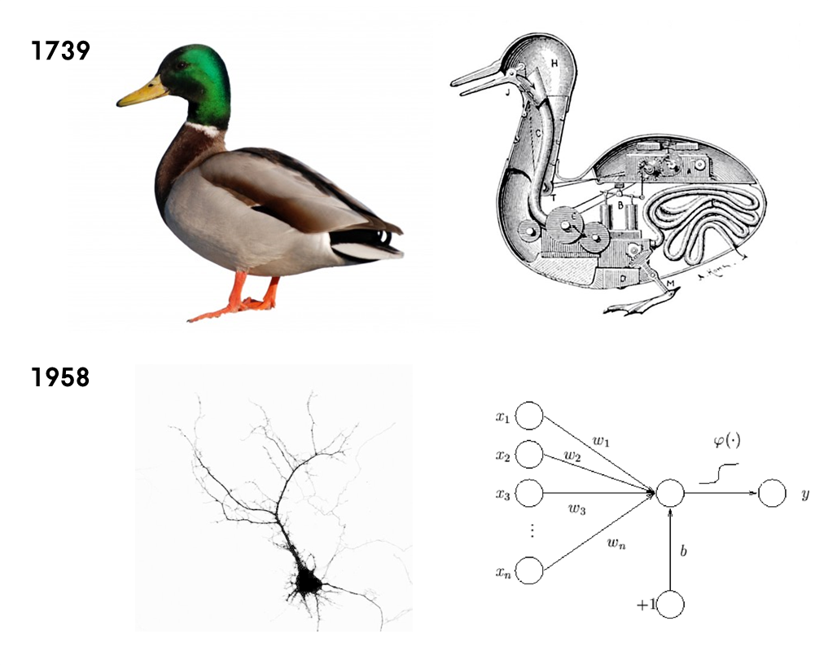
ARTIFICIAL NEURAL NETWORKS
ENGINEERING MACHINE LEARNING
HEALTH TECHNOLOGY

Slide 3
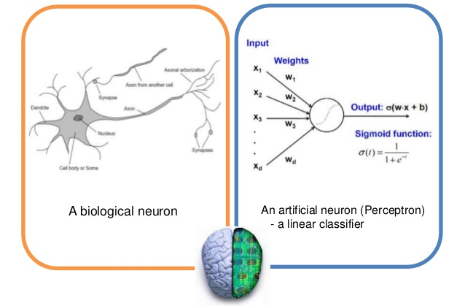
ARTIFICIAL NEURAL NETWORKS

Slide 4
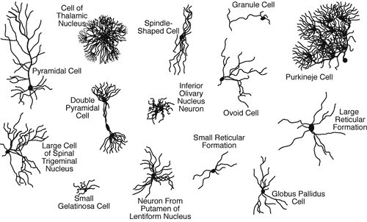
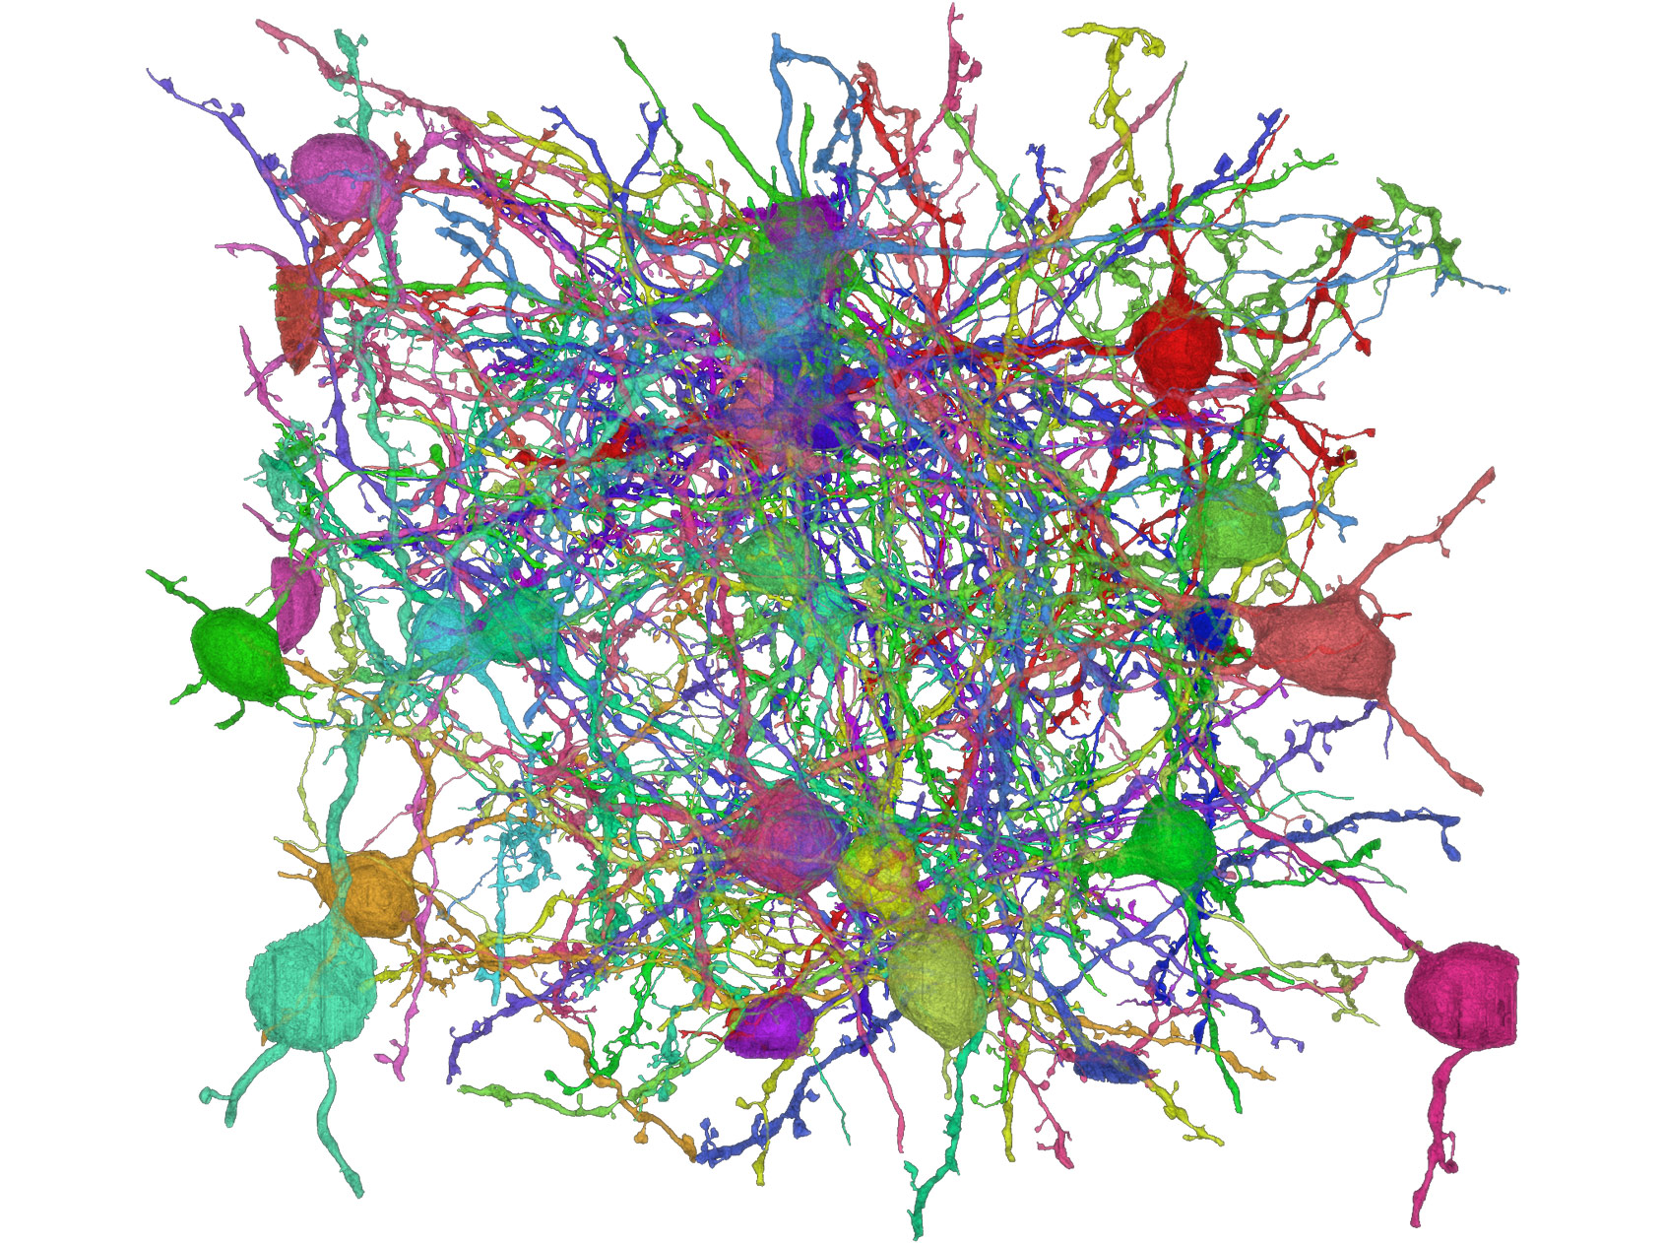
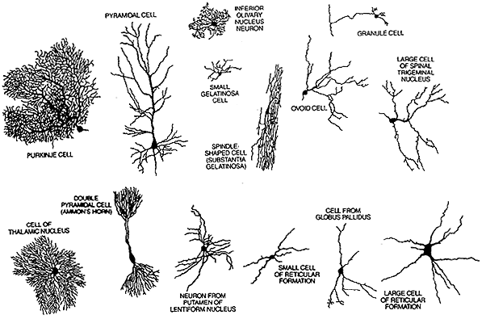
REAL NEURAL NETWORKS
https://ai.google/research/teams/perception/connectomics/

Slide 5
REAL NEURAL NETWORKS
Note, histology on stained samples typically only show a small part of the real number of cells..
https://ai.google/research/teams/perception/connectomics/

Slide 6
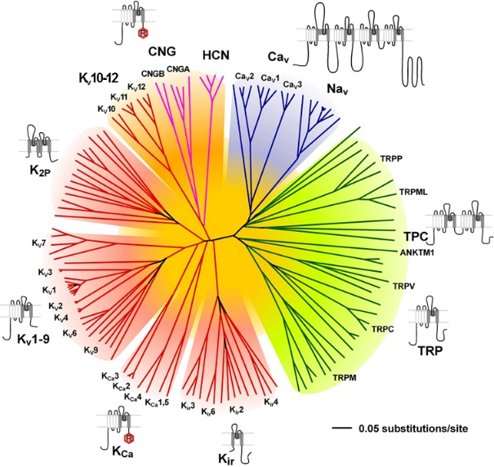
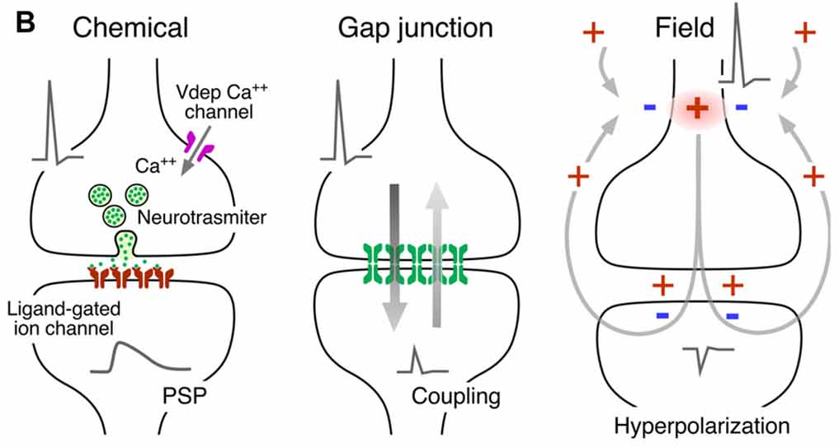
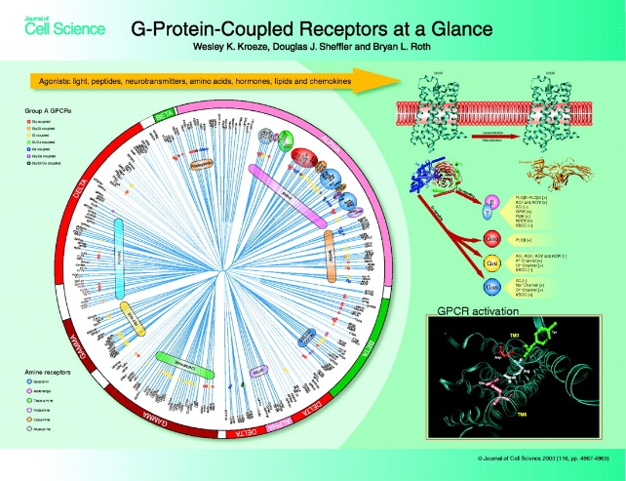
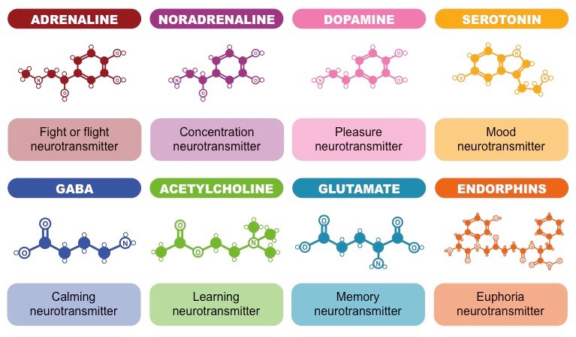
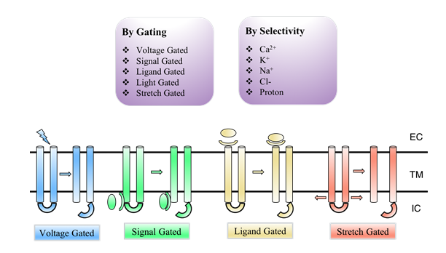
REAL NEURAL NETWORKS

Slide 7
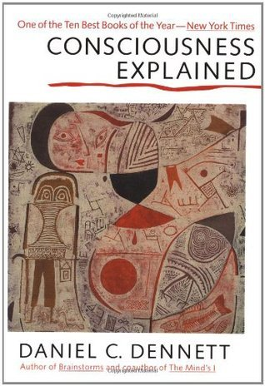
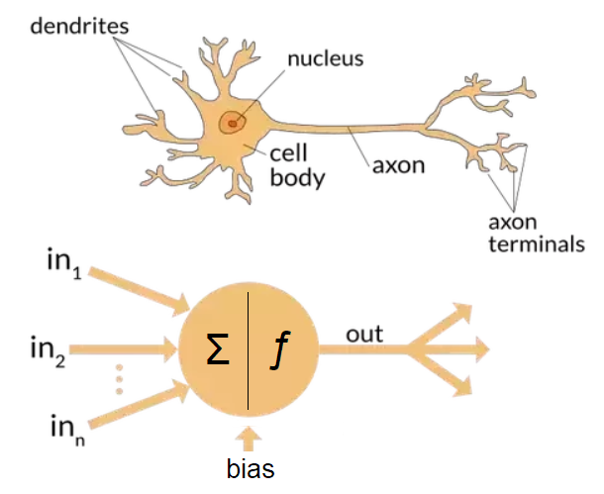
IDEALIZED NEURAL NETWORKS
COGNITION IS COMPUTATIONALLY INTRACTABLE
THEREFORE THE BRAIN CANNOT BE A COMPUTER
Turing machines

Slide 8
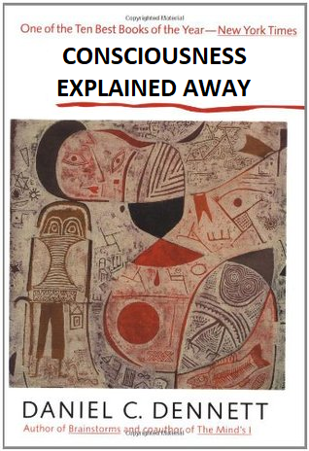
IDEALIZED NEURAL NETWORKS
COGNITION IS COMPUTATIONALLY INTRACTABLE
THEREFORE THE BRAIN CANNOT BE A COMPUTER
Turing machines

Slide 9
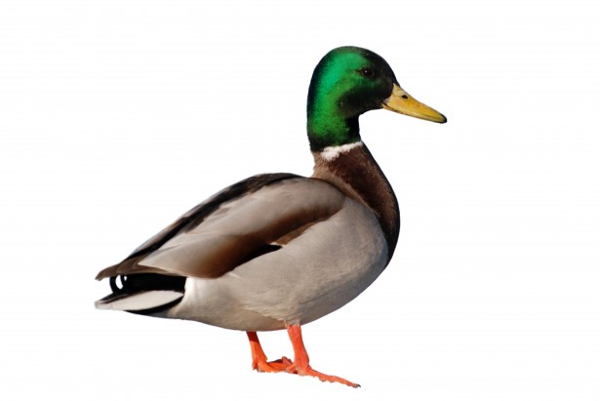
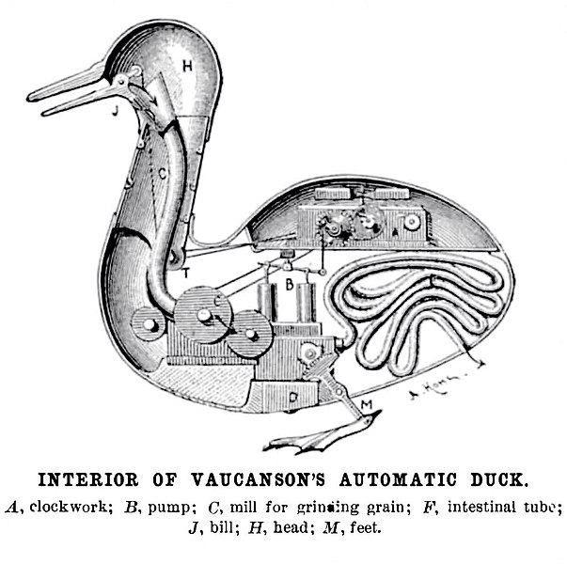
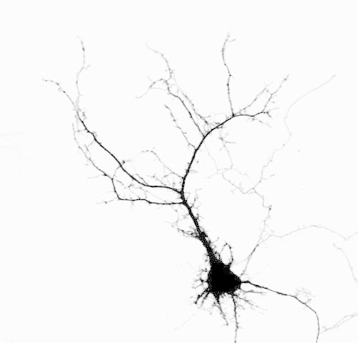
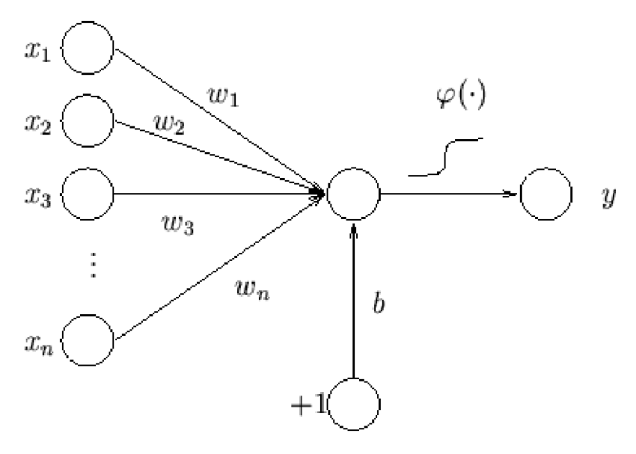
IDEALIZED NEURAL NETWORKS
1739
1958

Slide 10
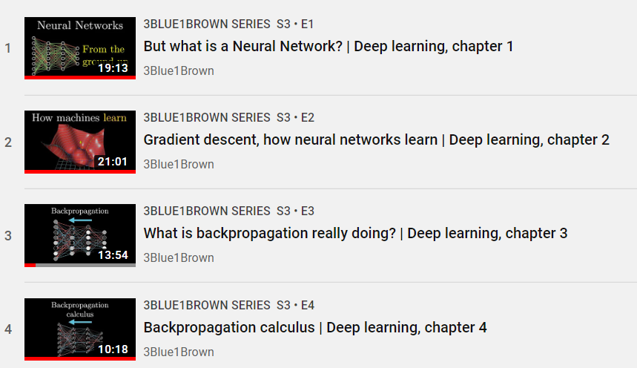
ARTIFICIAL NEURAL NETWORKS
ACTIVATION

Slide 11
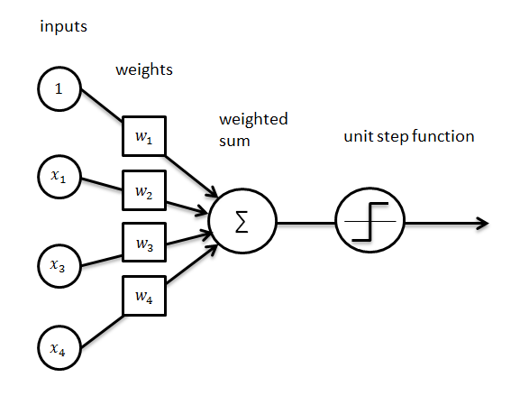
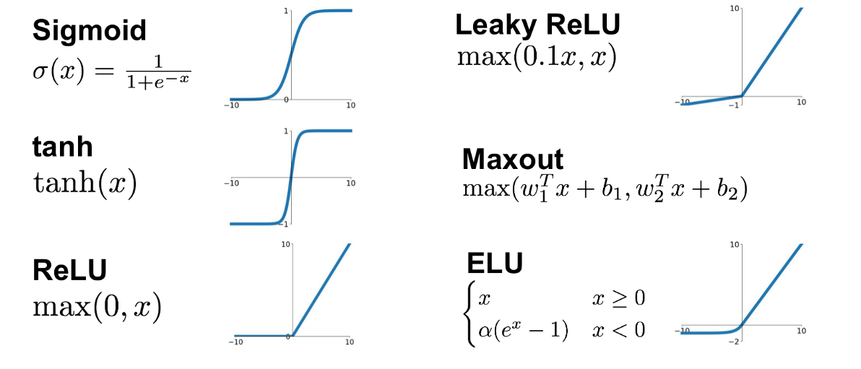
ARTIFICIAL NEURAL NETWORKS
ACTIVATION
activation function

Slide 12
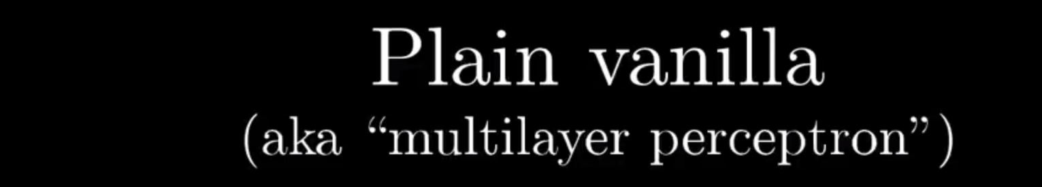
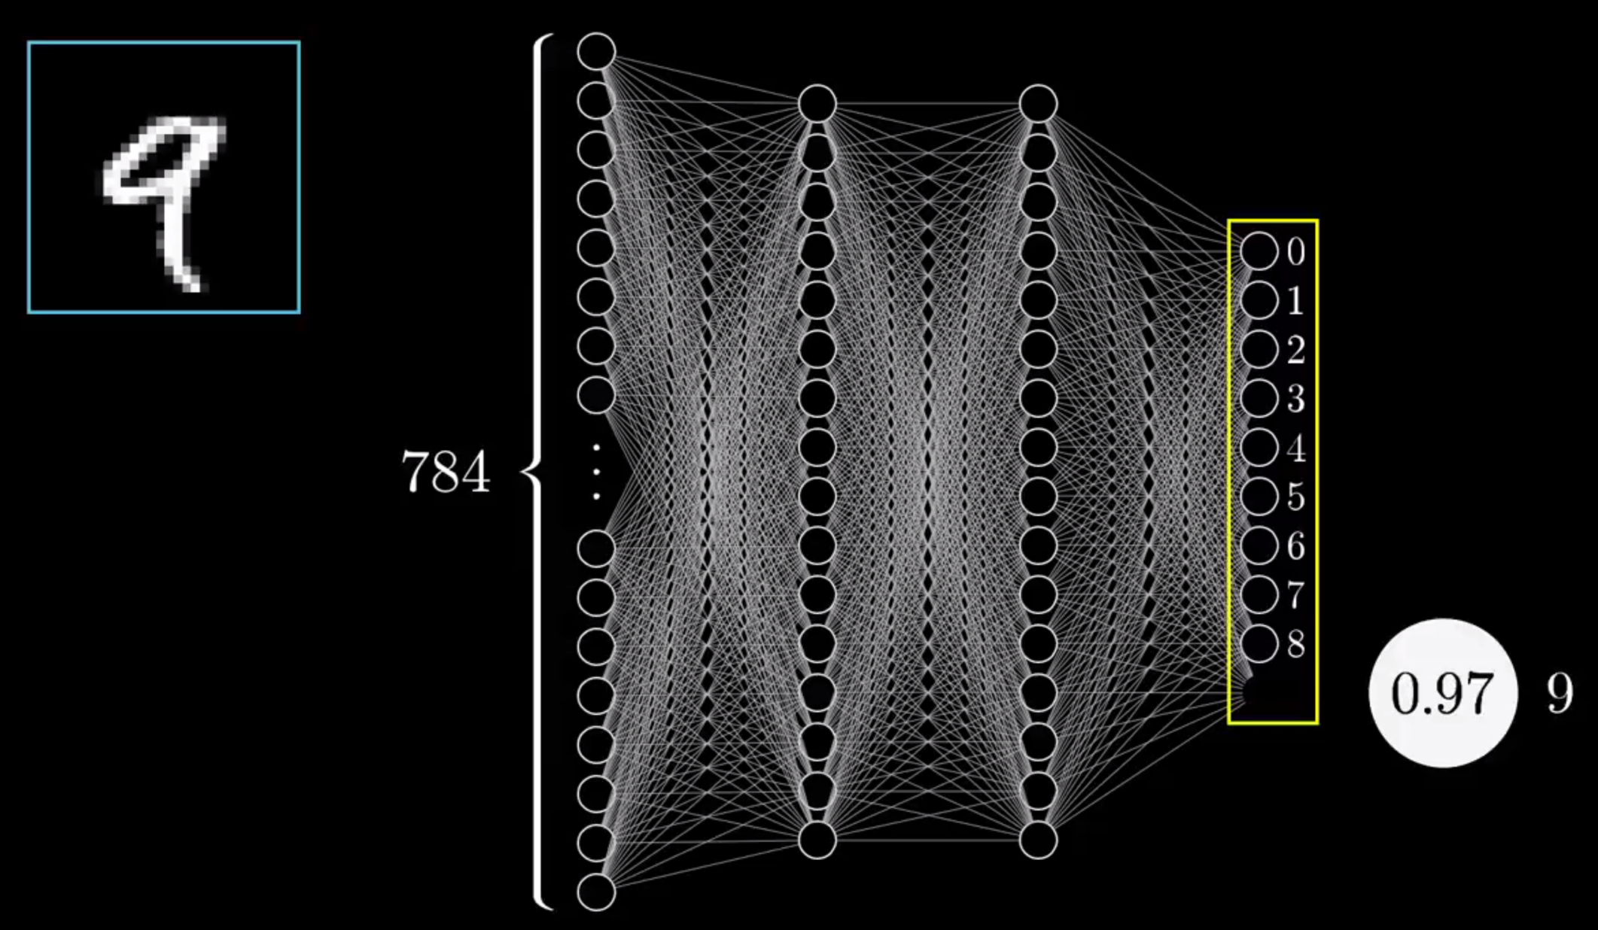
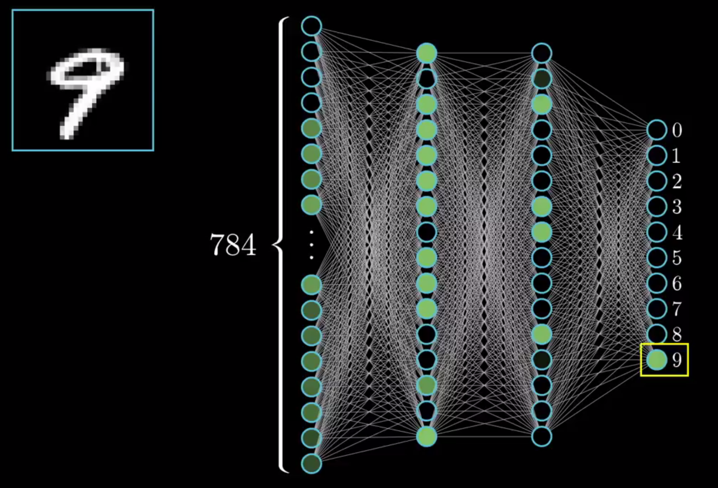
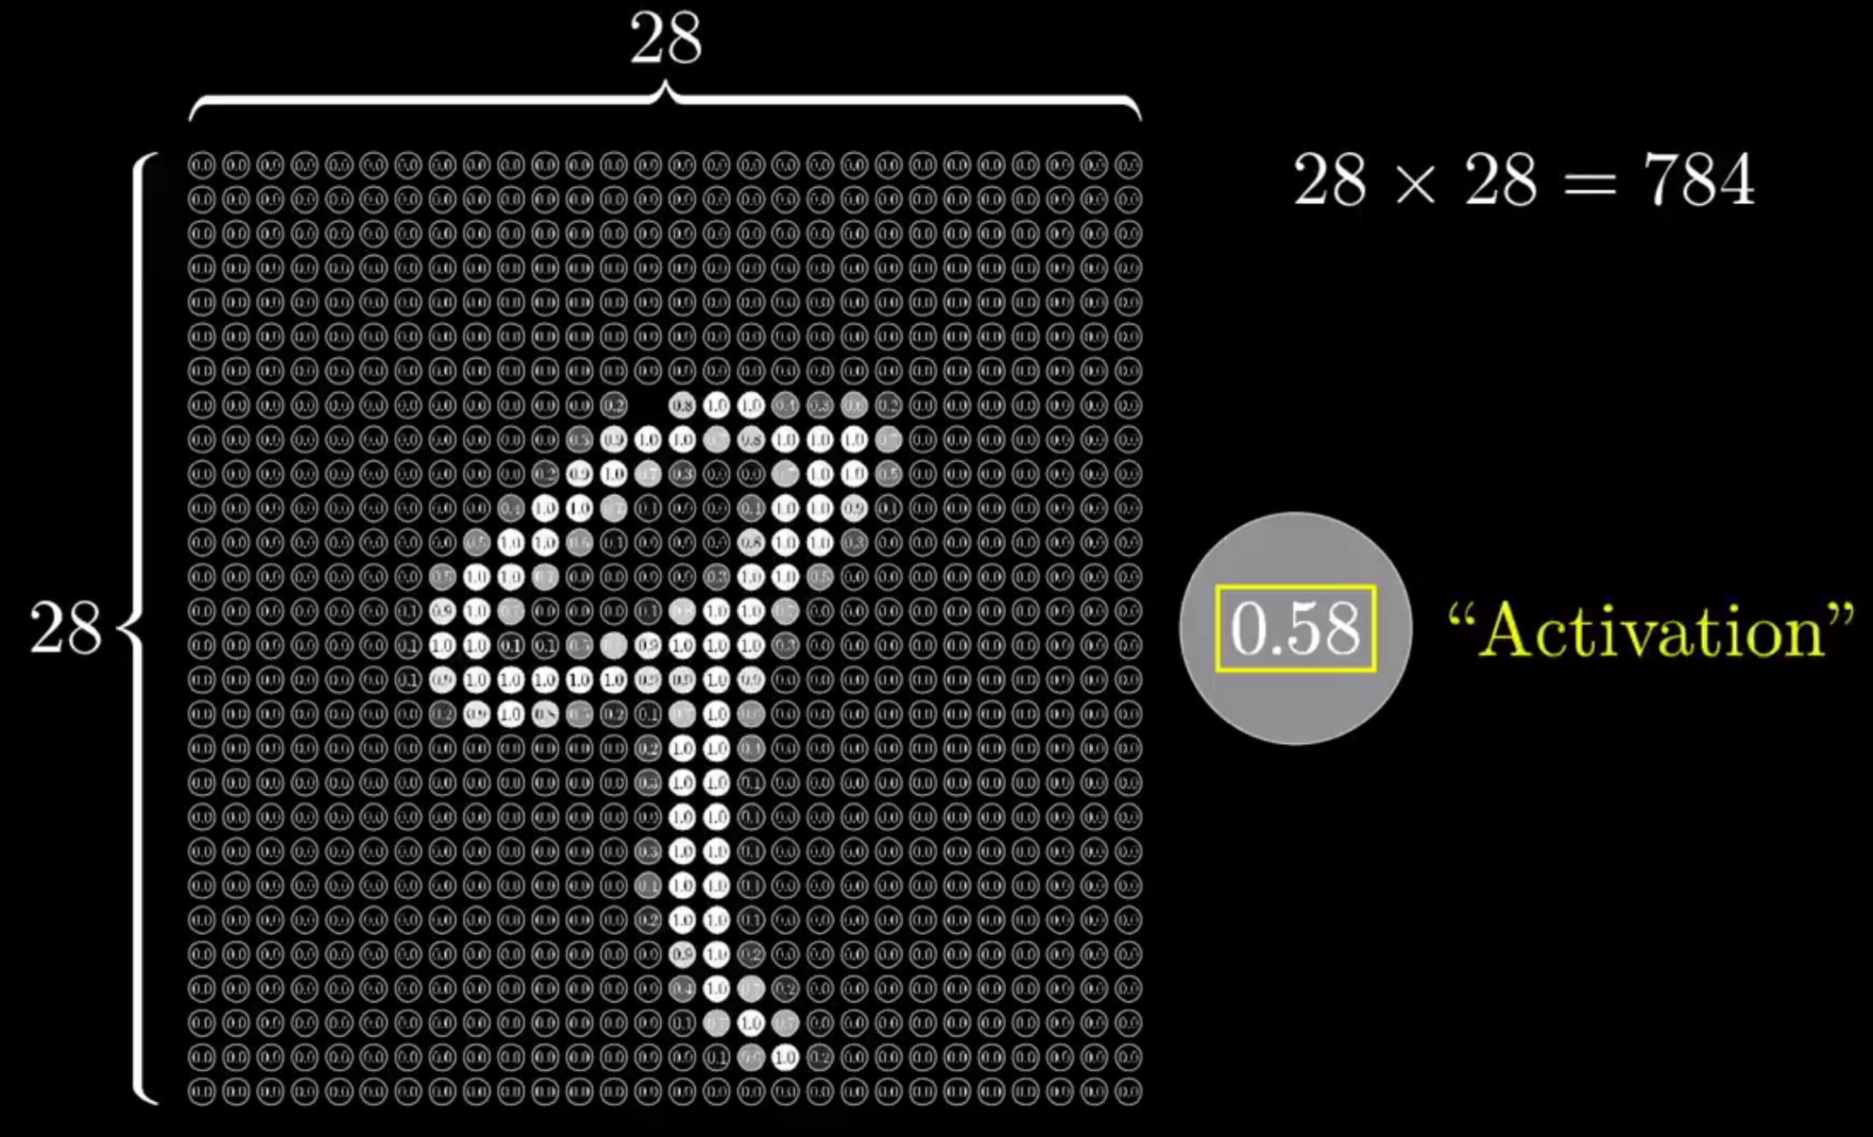
ARTIFICIAL NEURAL NETWORKS
ACTIVATION

Slide 13
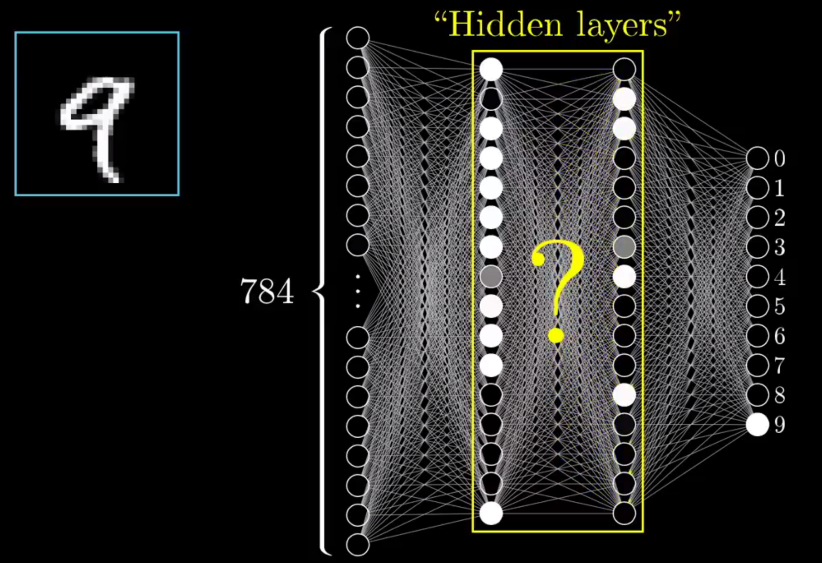
ARTIFICIAL NEURAL NETWORKS
POSSIBLE MEANING

Slide 14
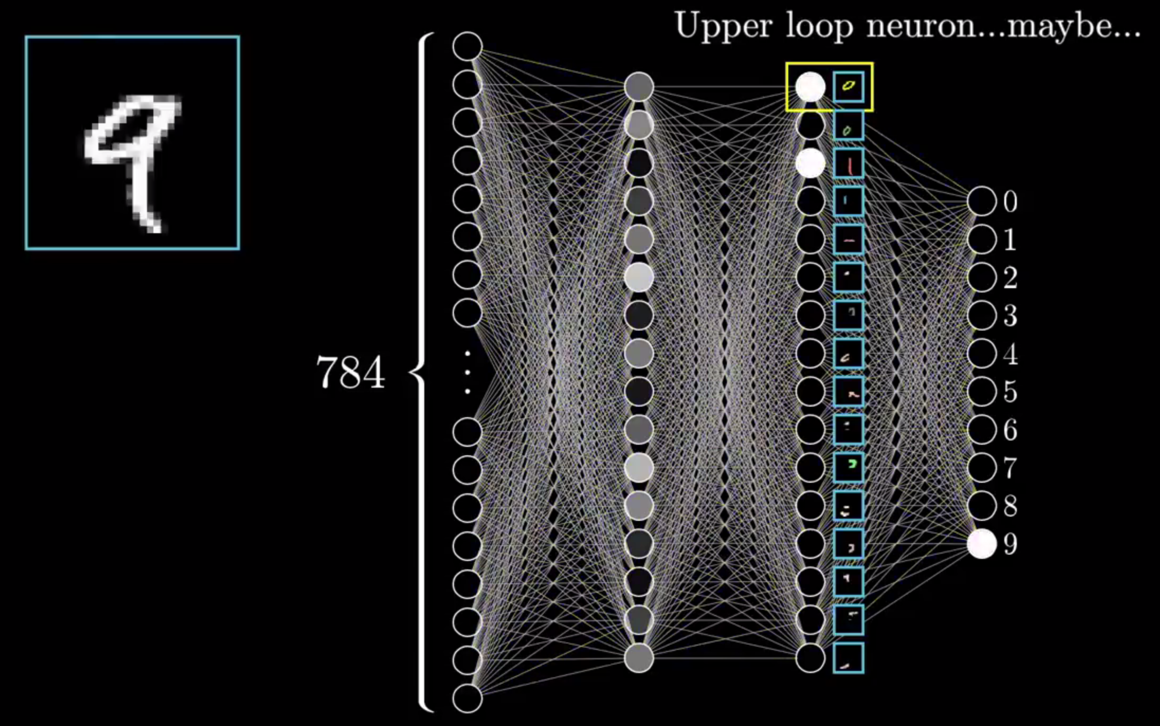
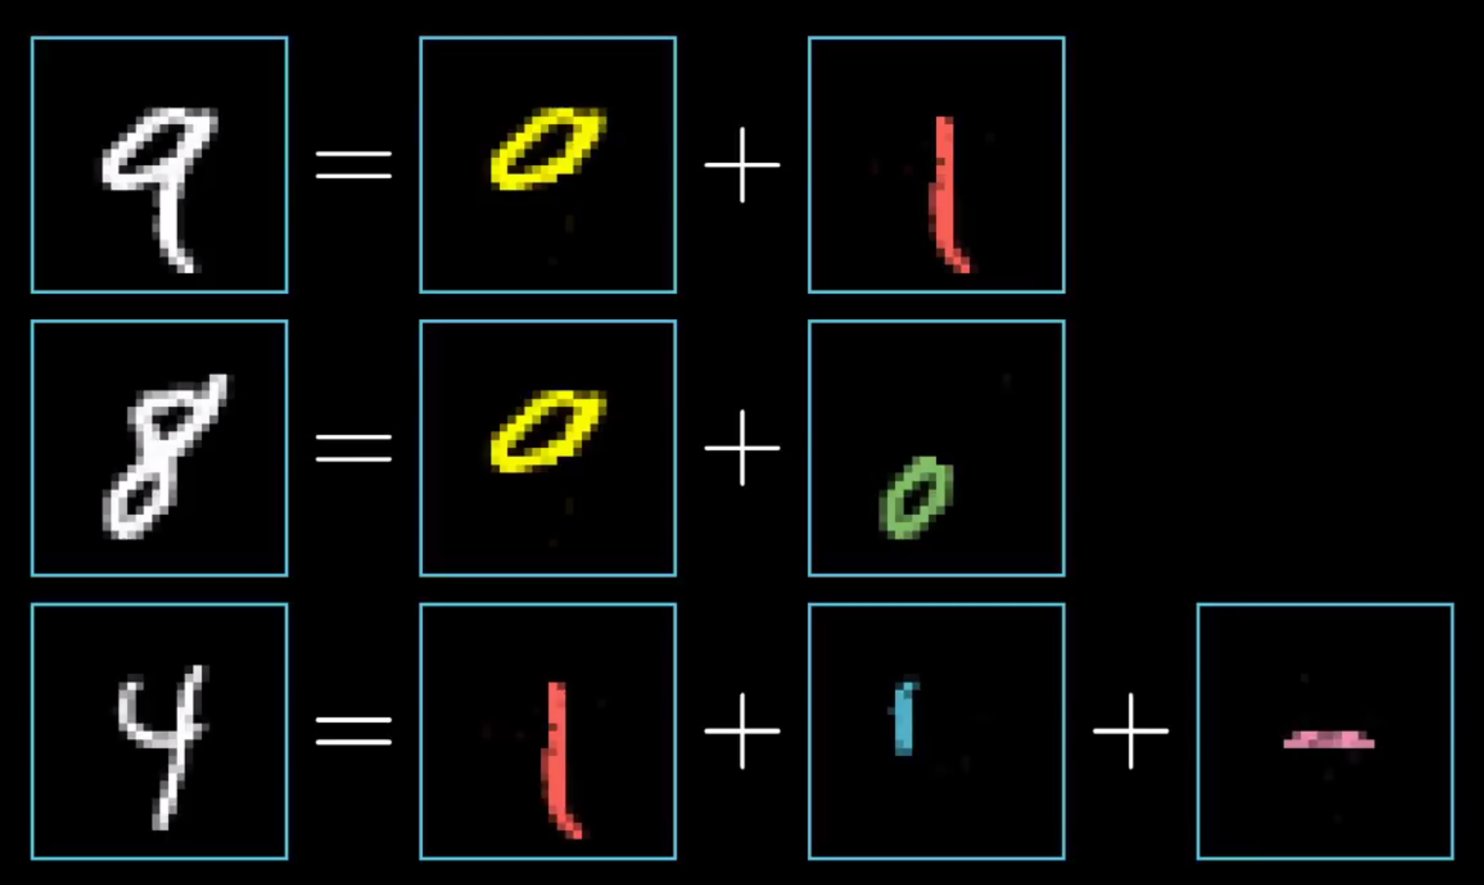
ARTIFICIAL NEURAL NETWORKS
POSSIBLE MEANING – LAYERS OF ABSTRACTION

Slide 15
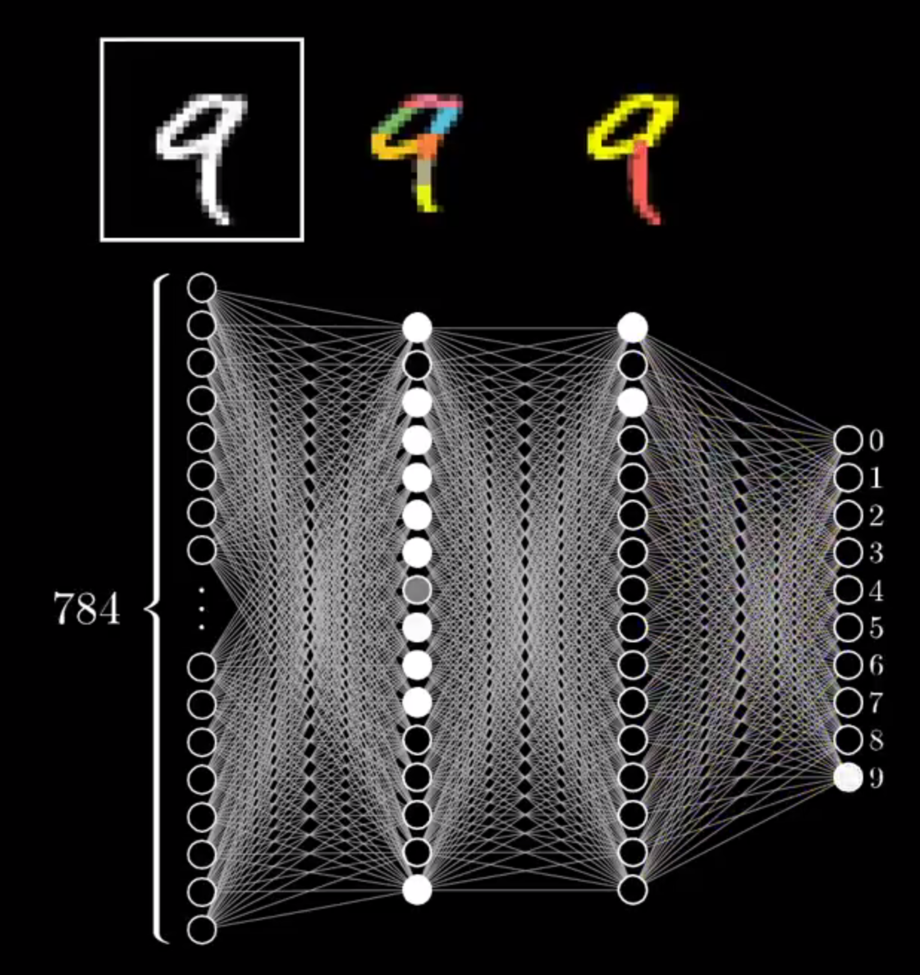
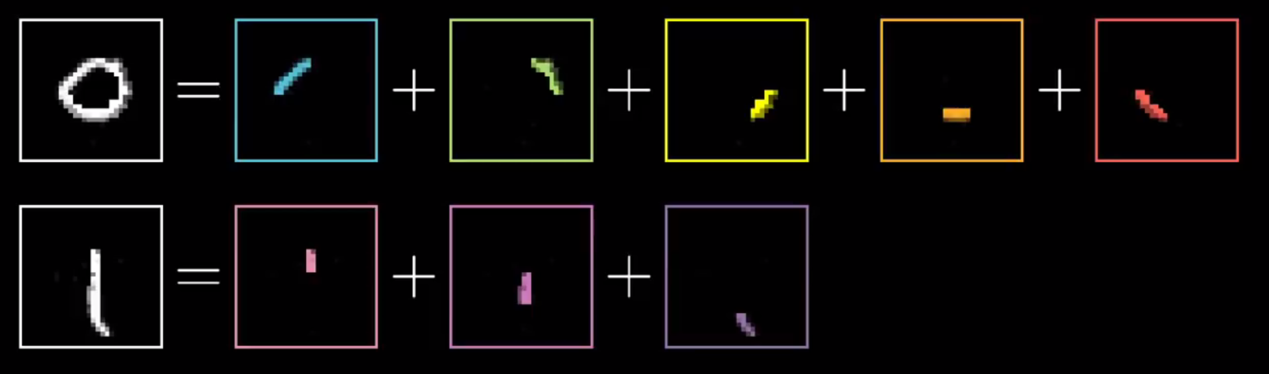
ARTIFICIAL NEURAL NETWORKS
POSSIBLE MEANING – LAYERS OF ABSTRACTION

Slide 16
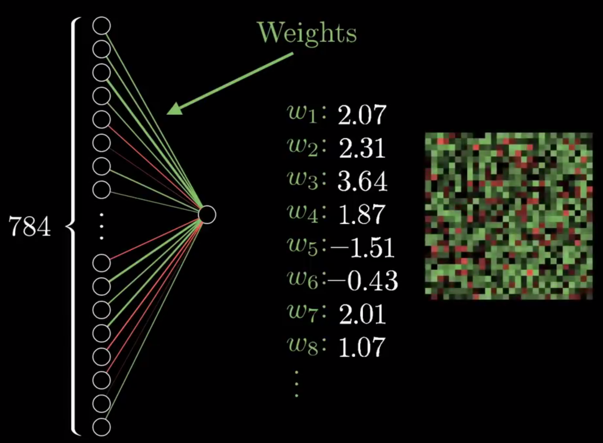
ARTIFICIAL NEURAL NETWORKS
WEIGHTS

Slide 17
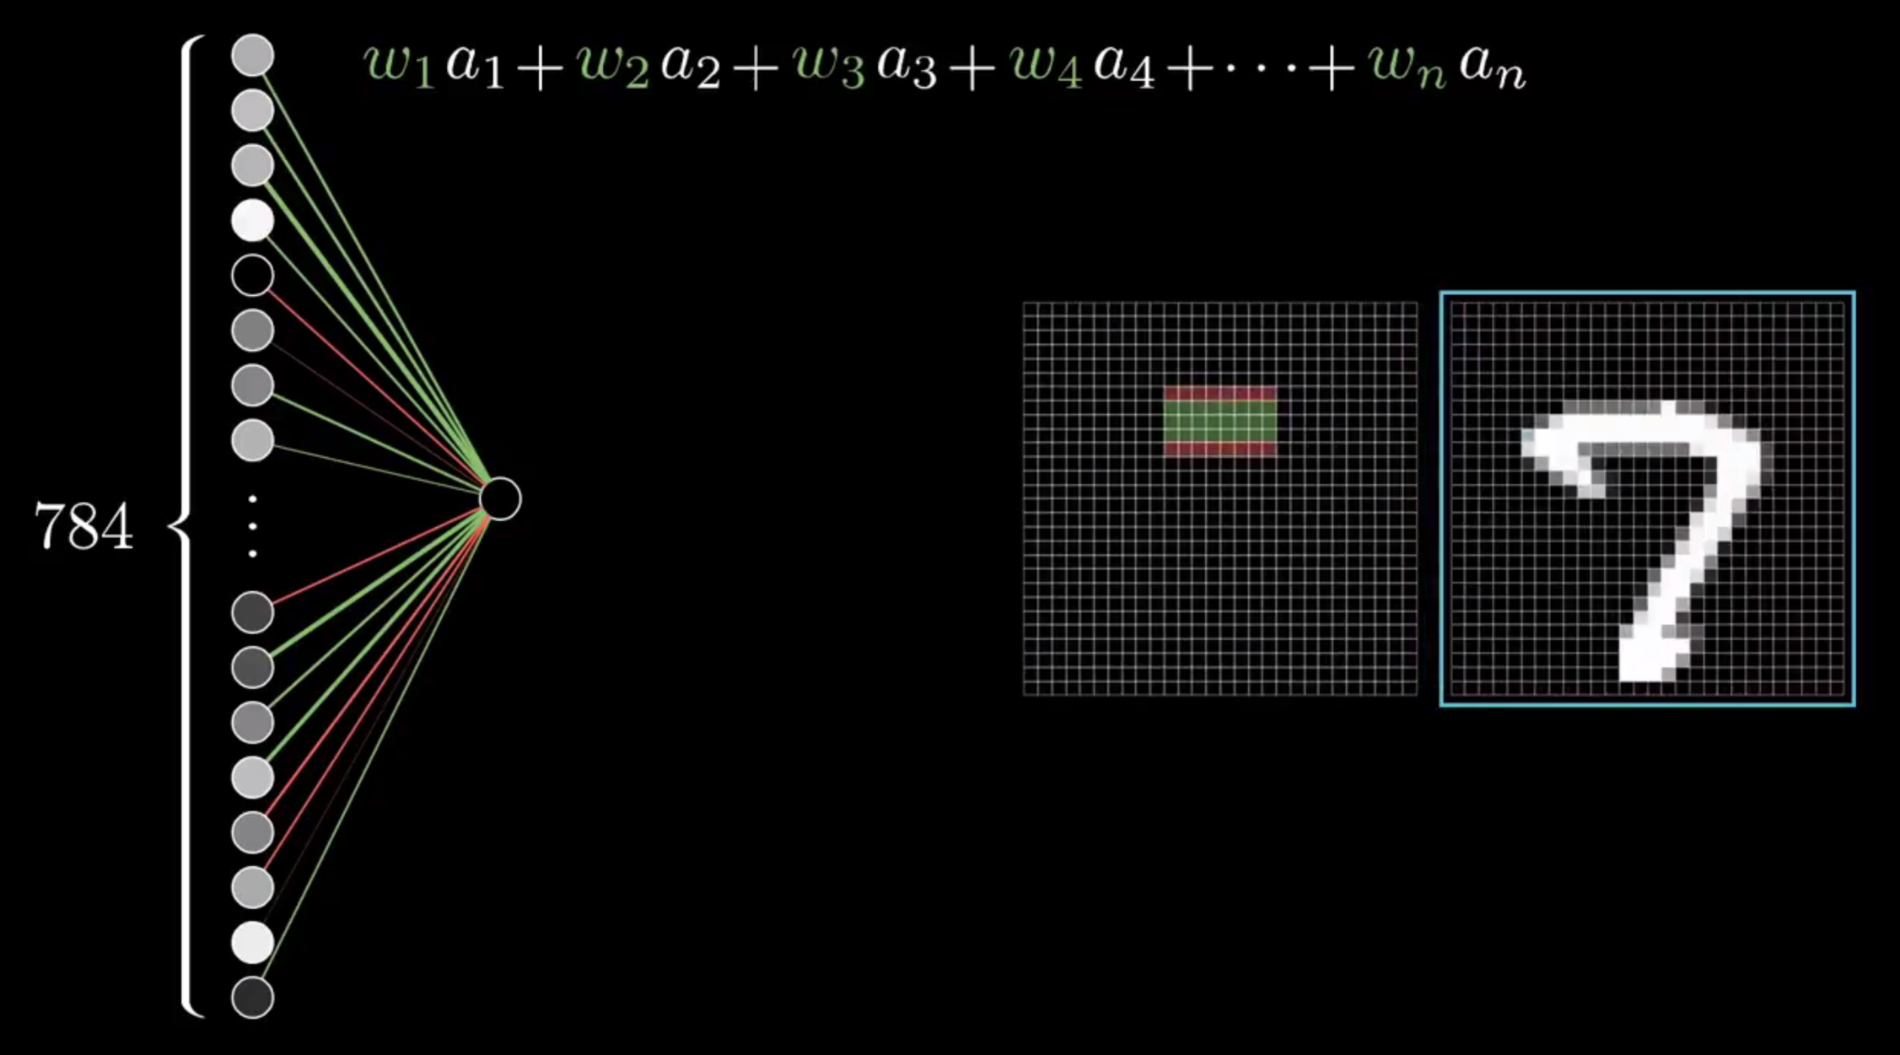
ARTIFICIAL NEURAL NETWORKS
WEIGHTS

Slide 18
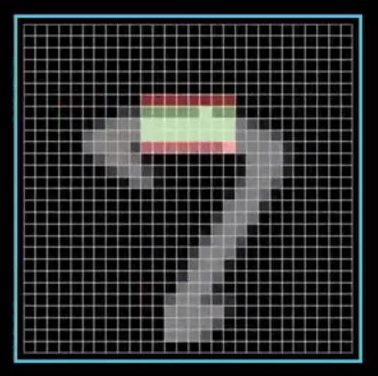
ARTIFICIAL NEURAL NETWORKS
WEIGHTS

Slide 19
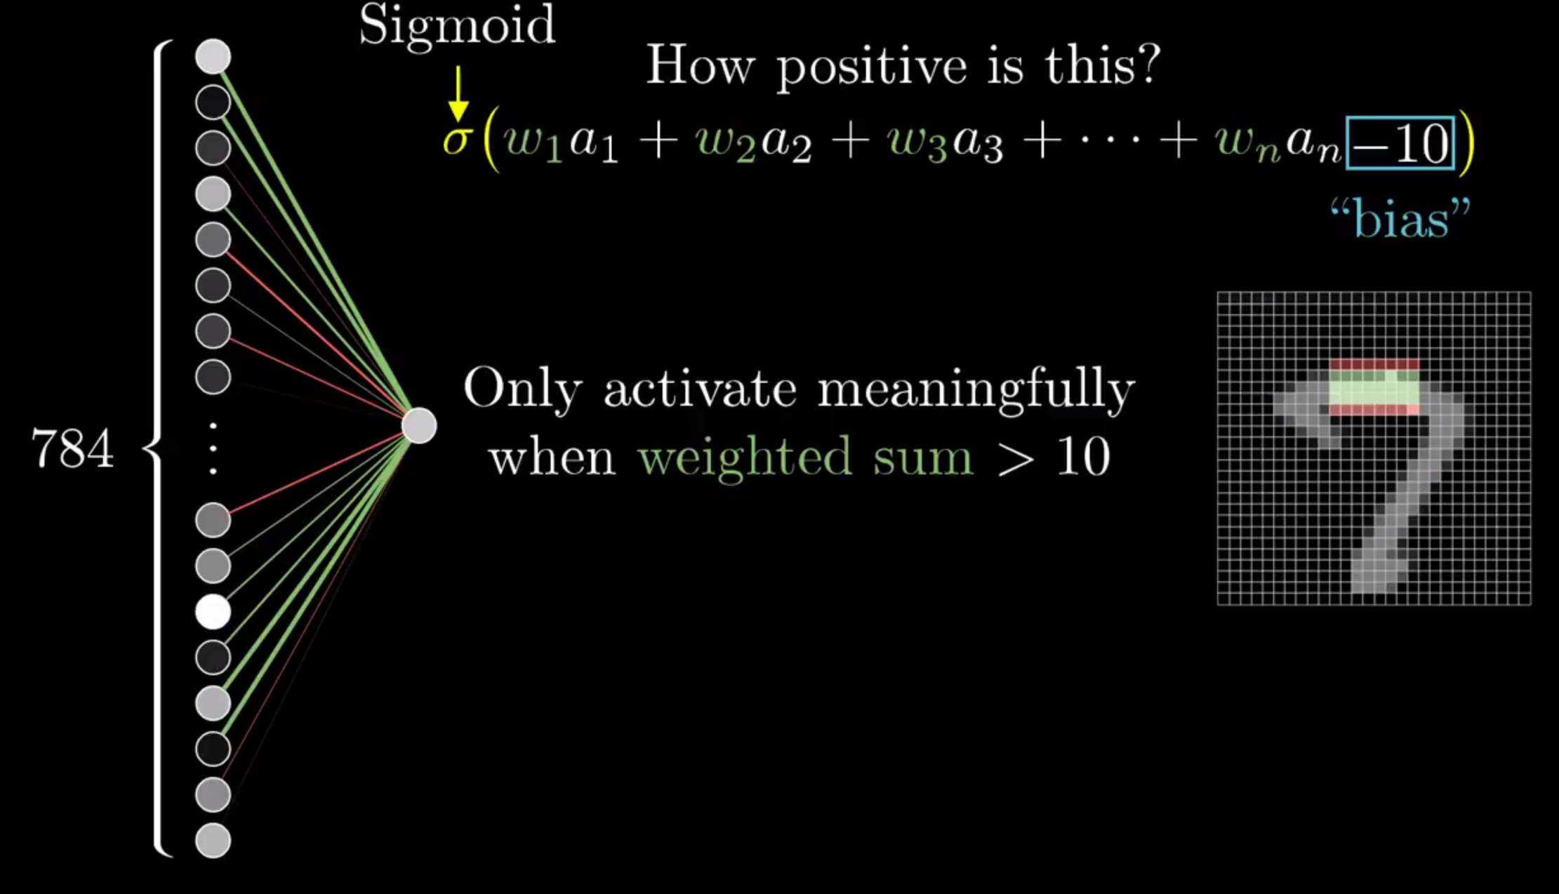
ARTIFICIAL NEURAL NETWORKS
BIAS

Slide 20
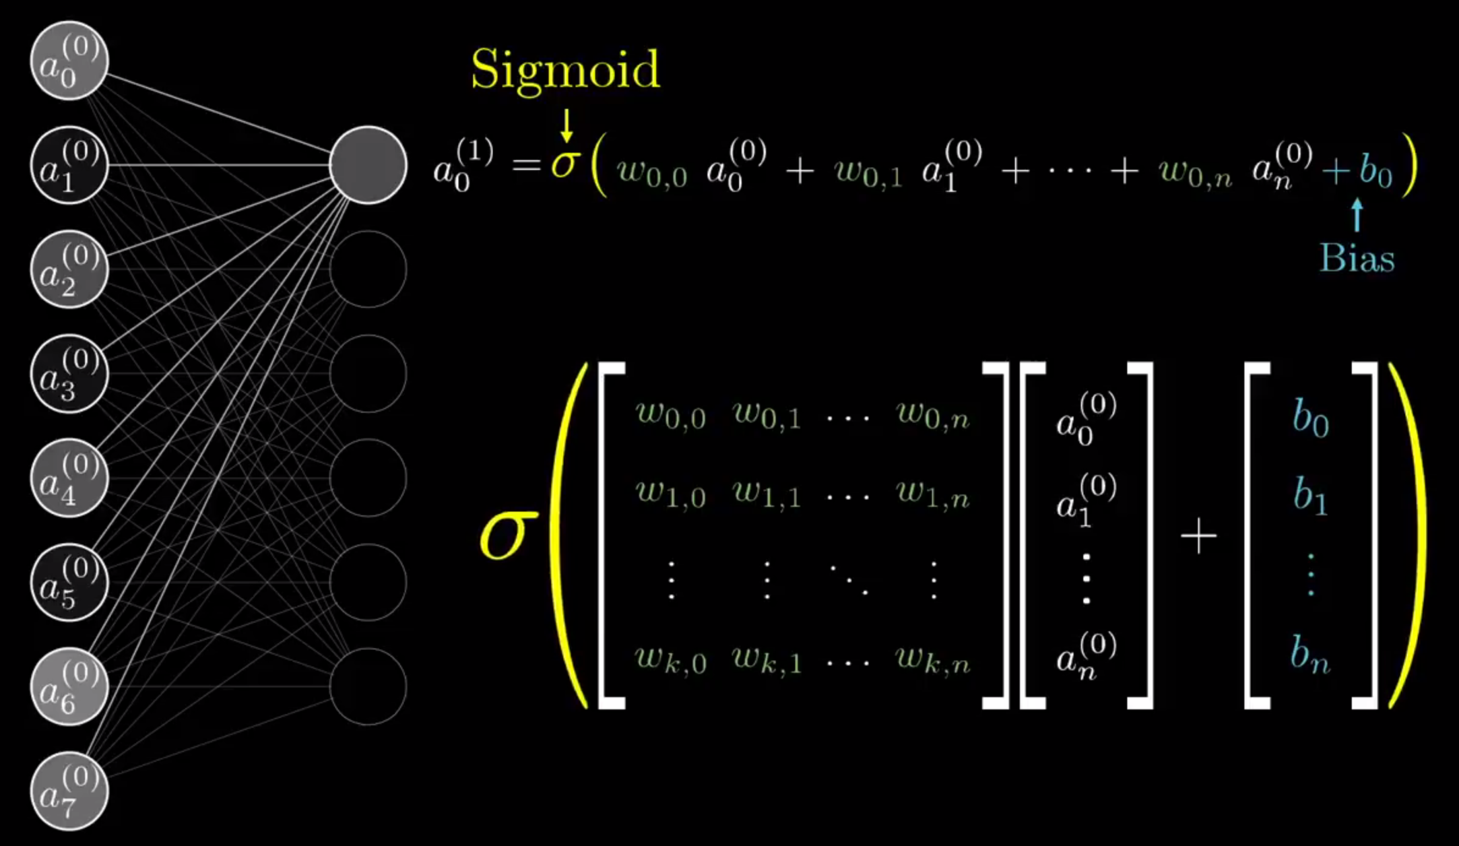
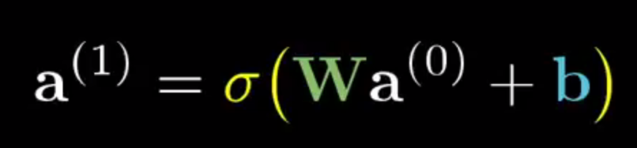
ARTIFICIAL NEURAL NETWORKS
MATRIX FORM

Slide 21
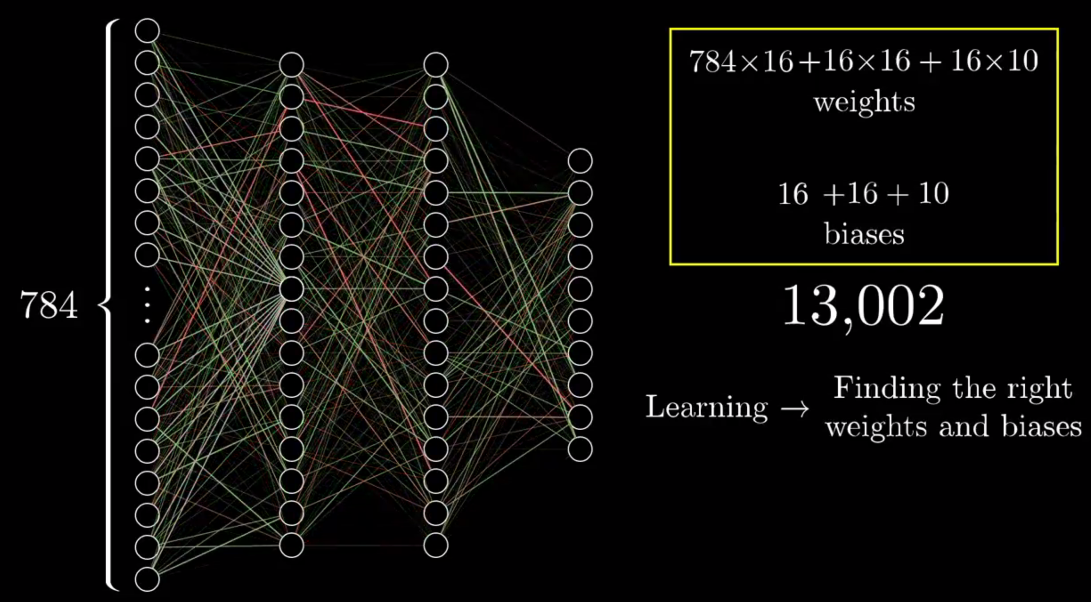
ARTIFICIAL NEURAL NETWORKS
LEARNING

Slide 22
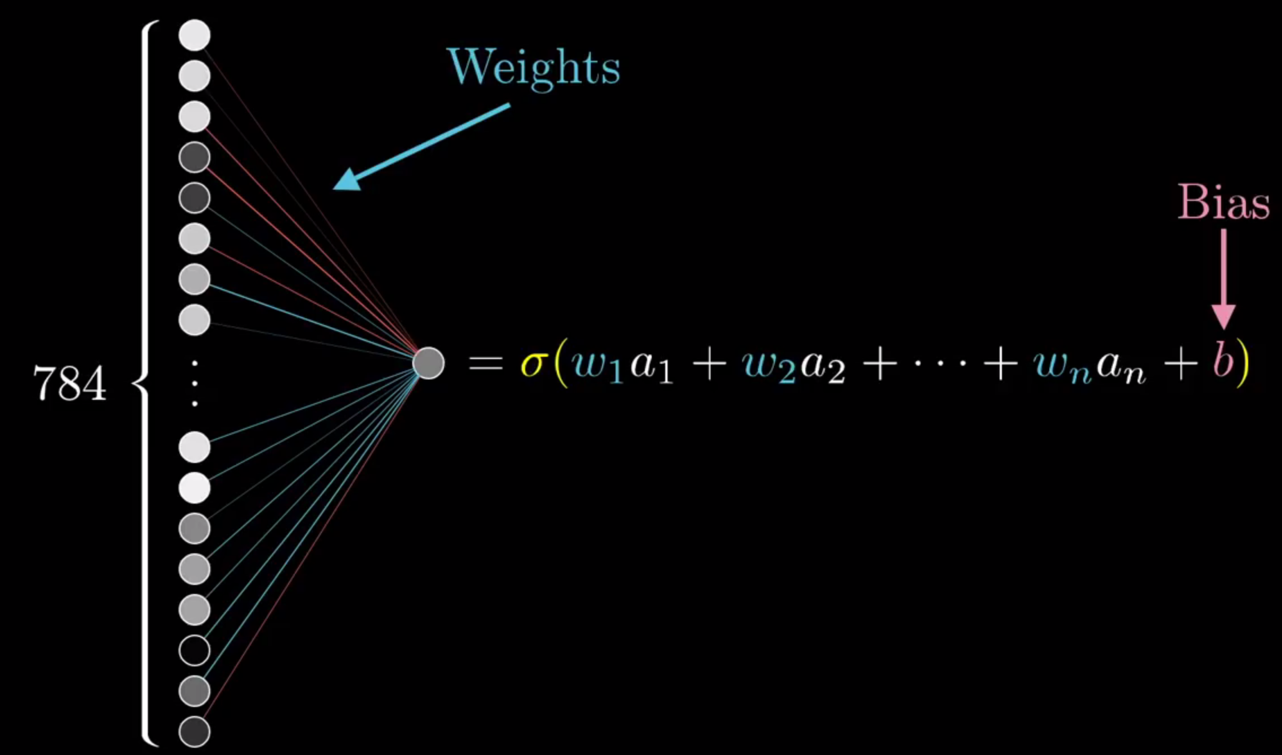
ARTIFICIAL NEURAL NETWORKS
LEARNING

Slide 23
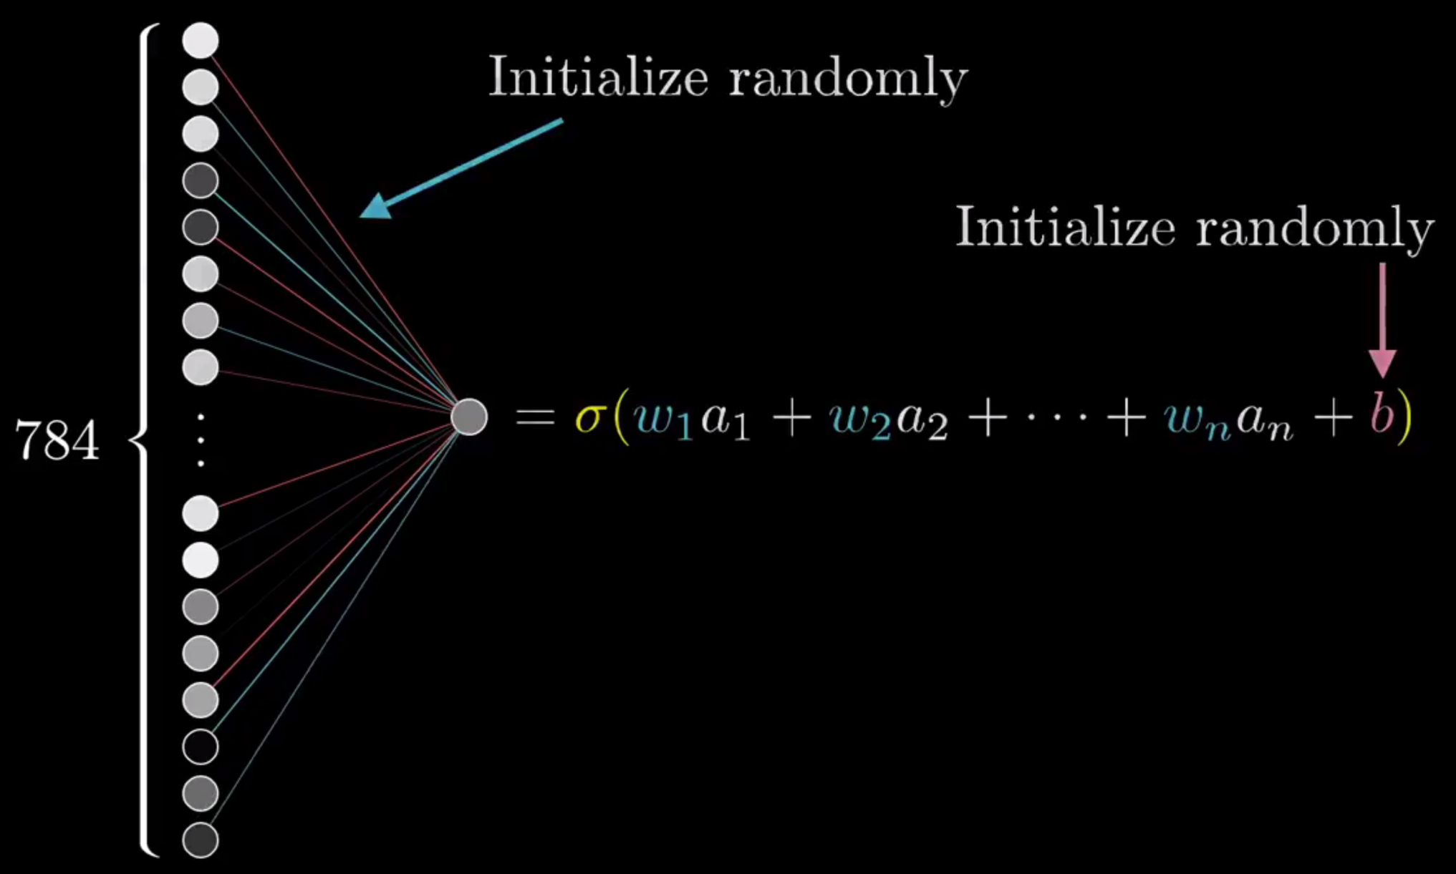
ARTIFICIAL NEURAL NETWORKS
LEARNING

Slide 24
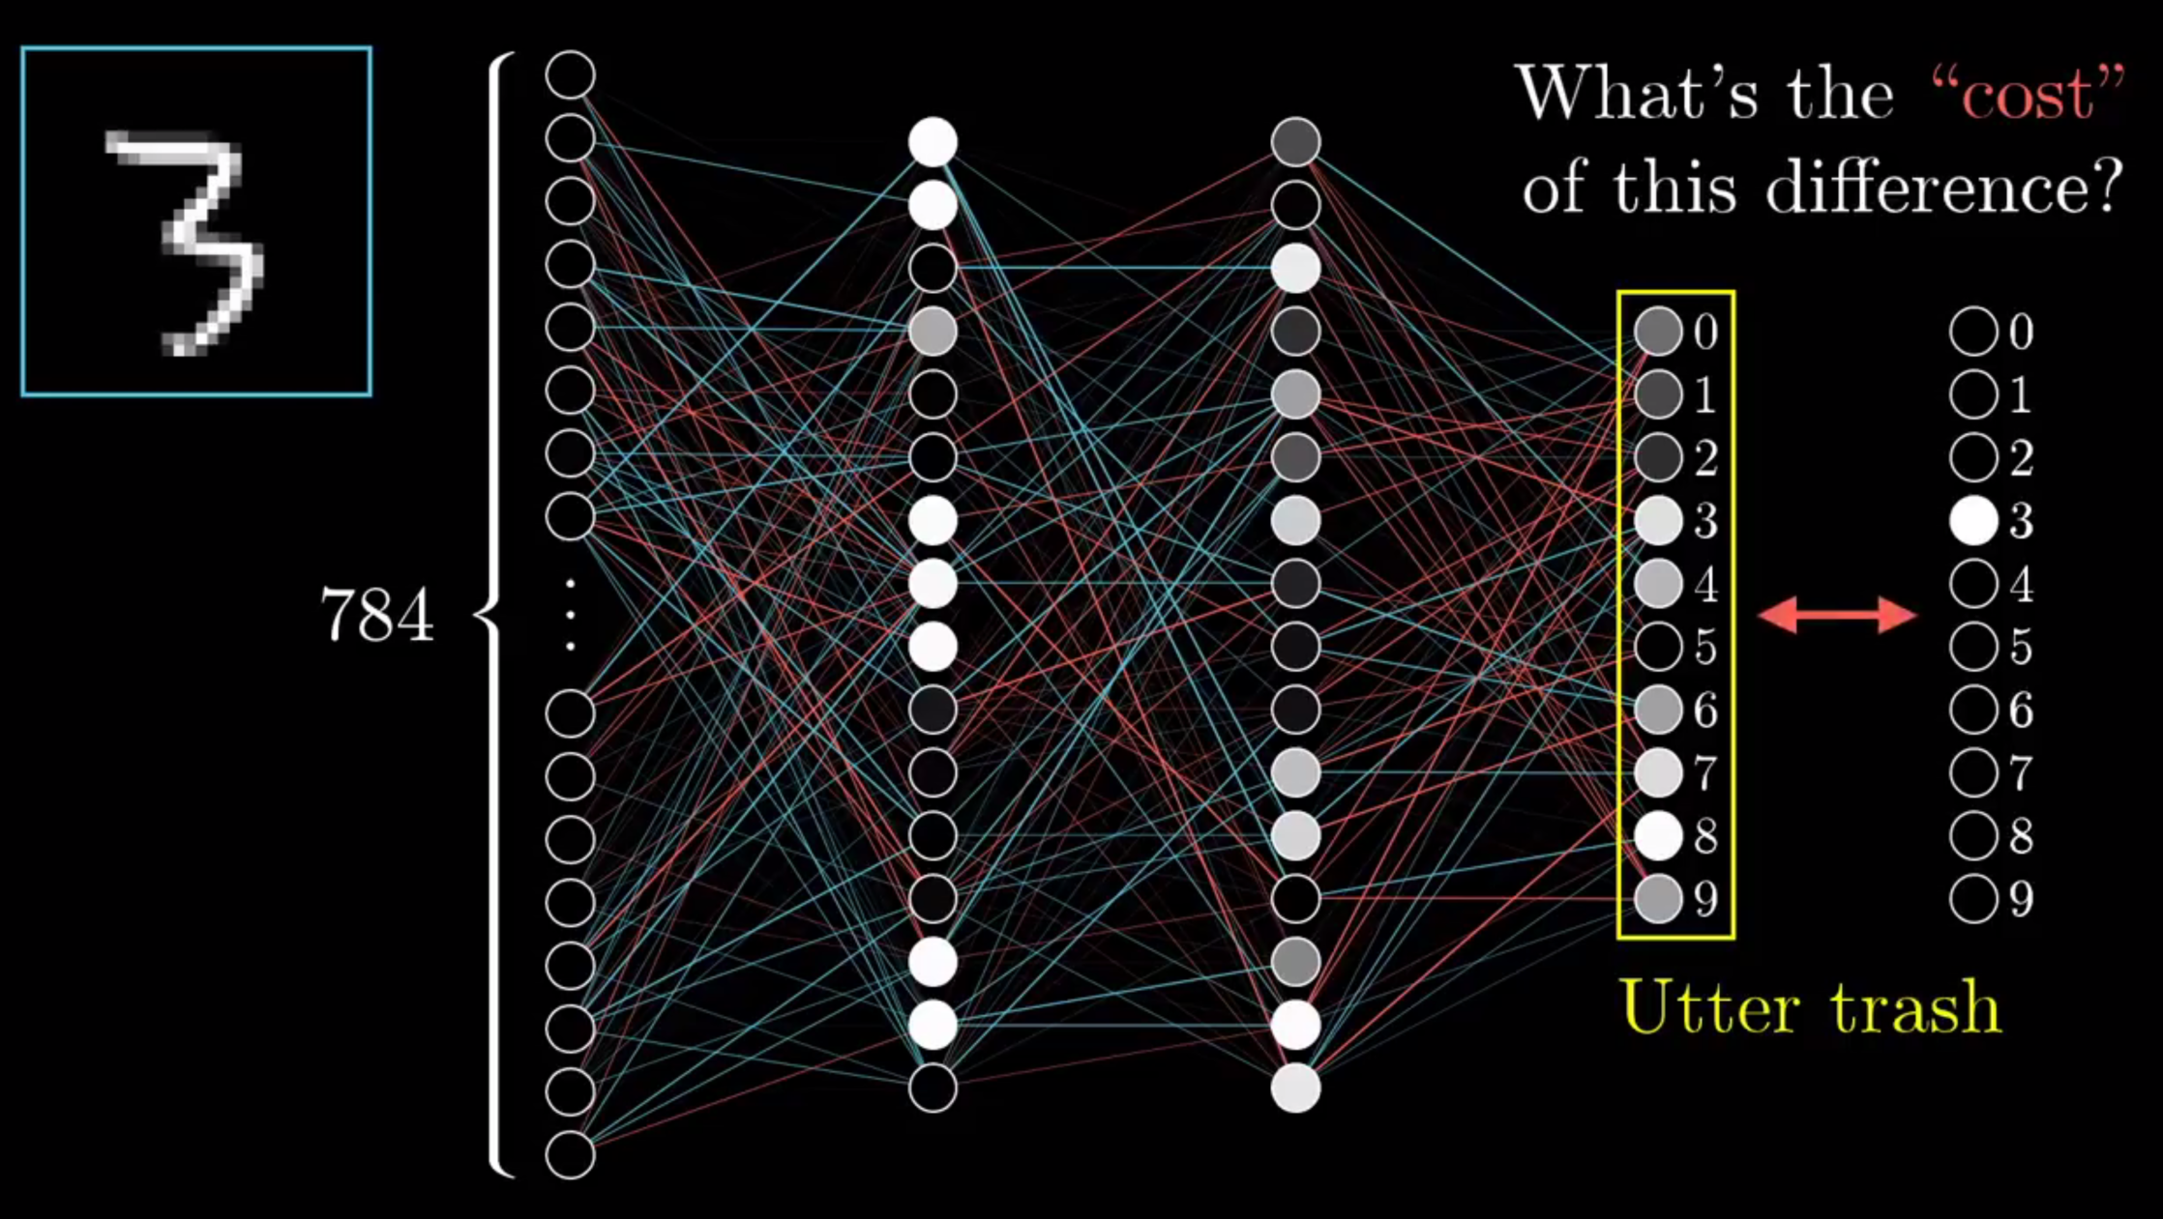
ARTIFICIAL NEURAL NETWORKS
LEARNING

Slide 25
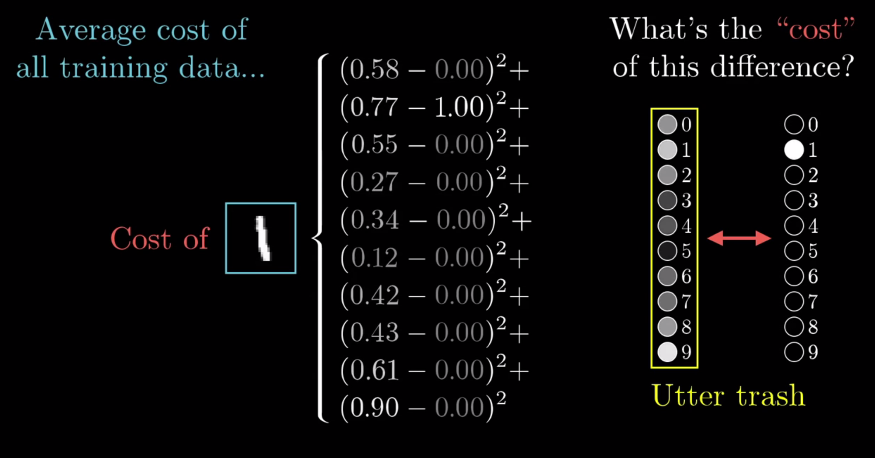
ARTIFICIAL NEURAL NETWORKS
LEARNING

Slide 26
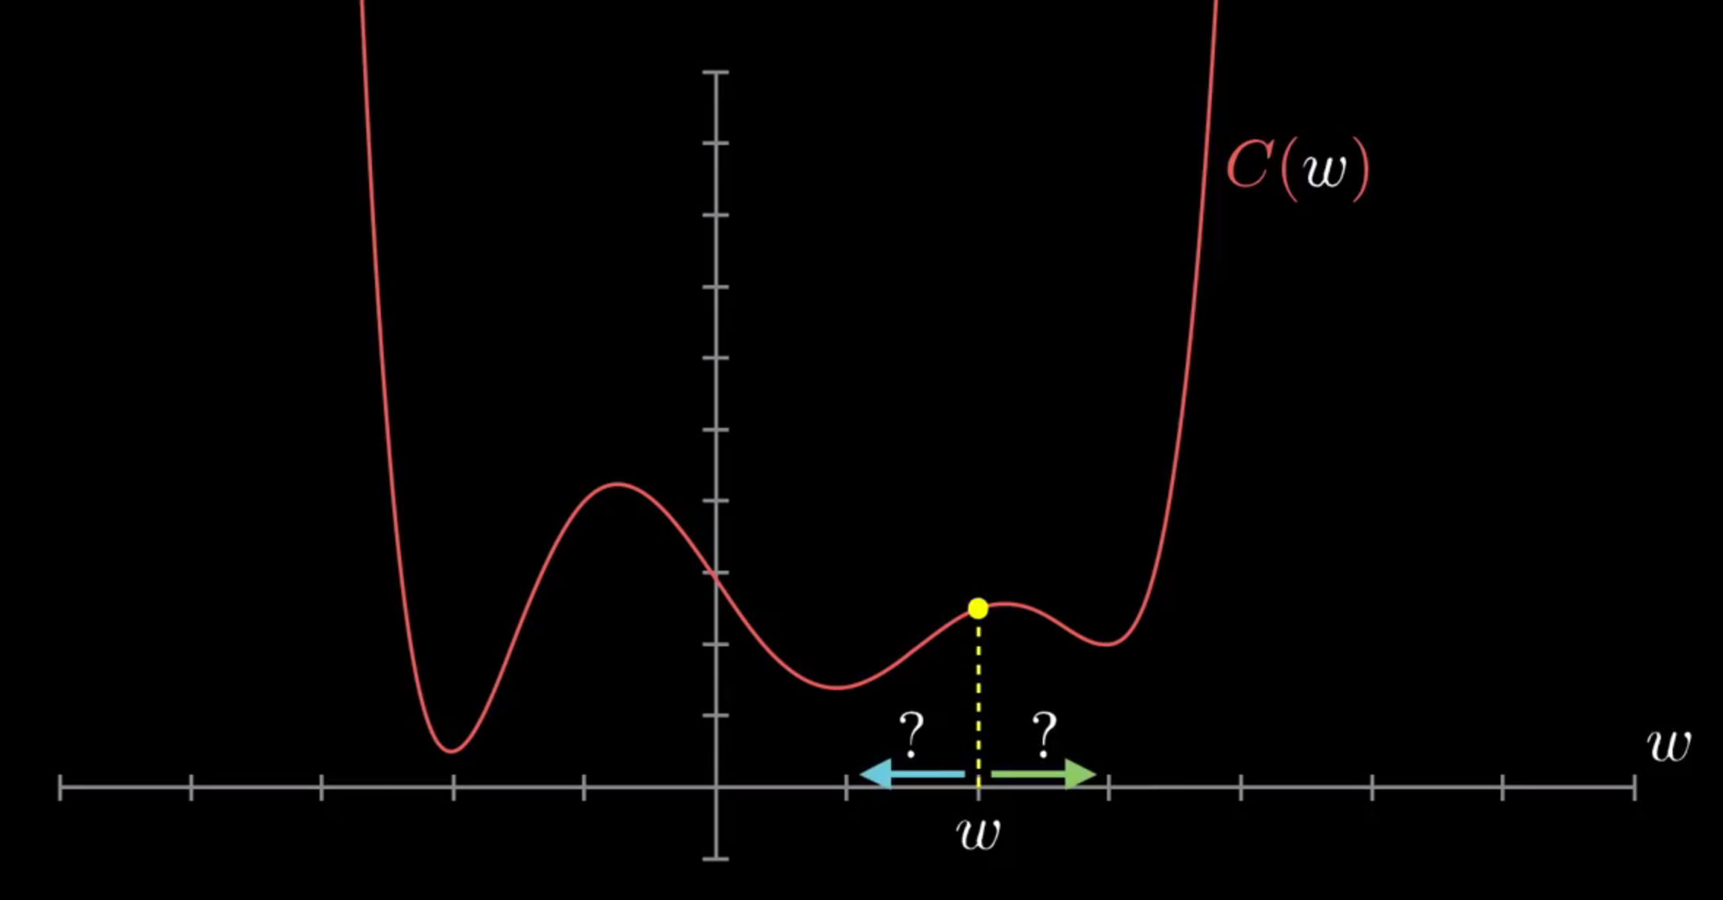
ARTIFICIAL NEURAL NETWORKS
LEARNING

Slide 27
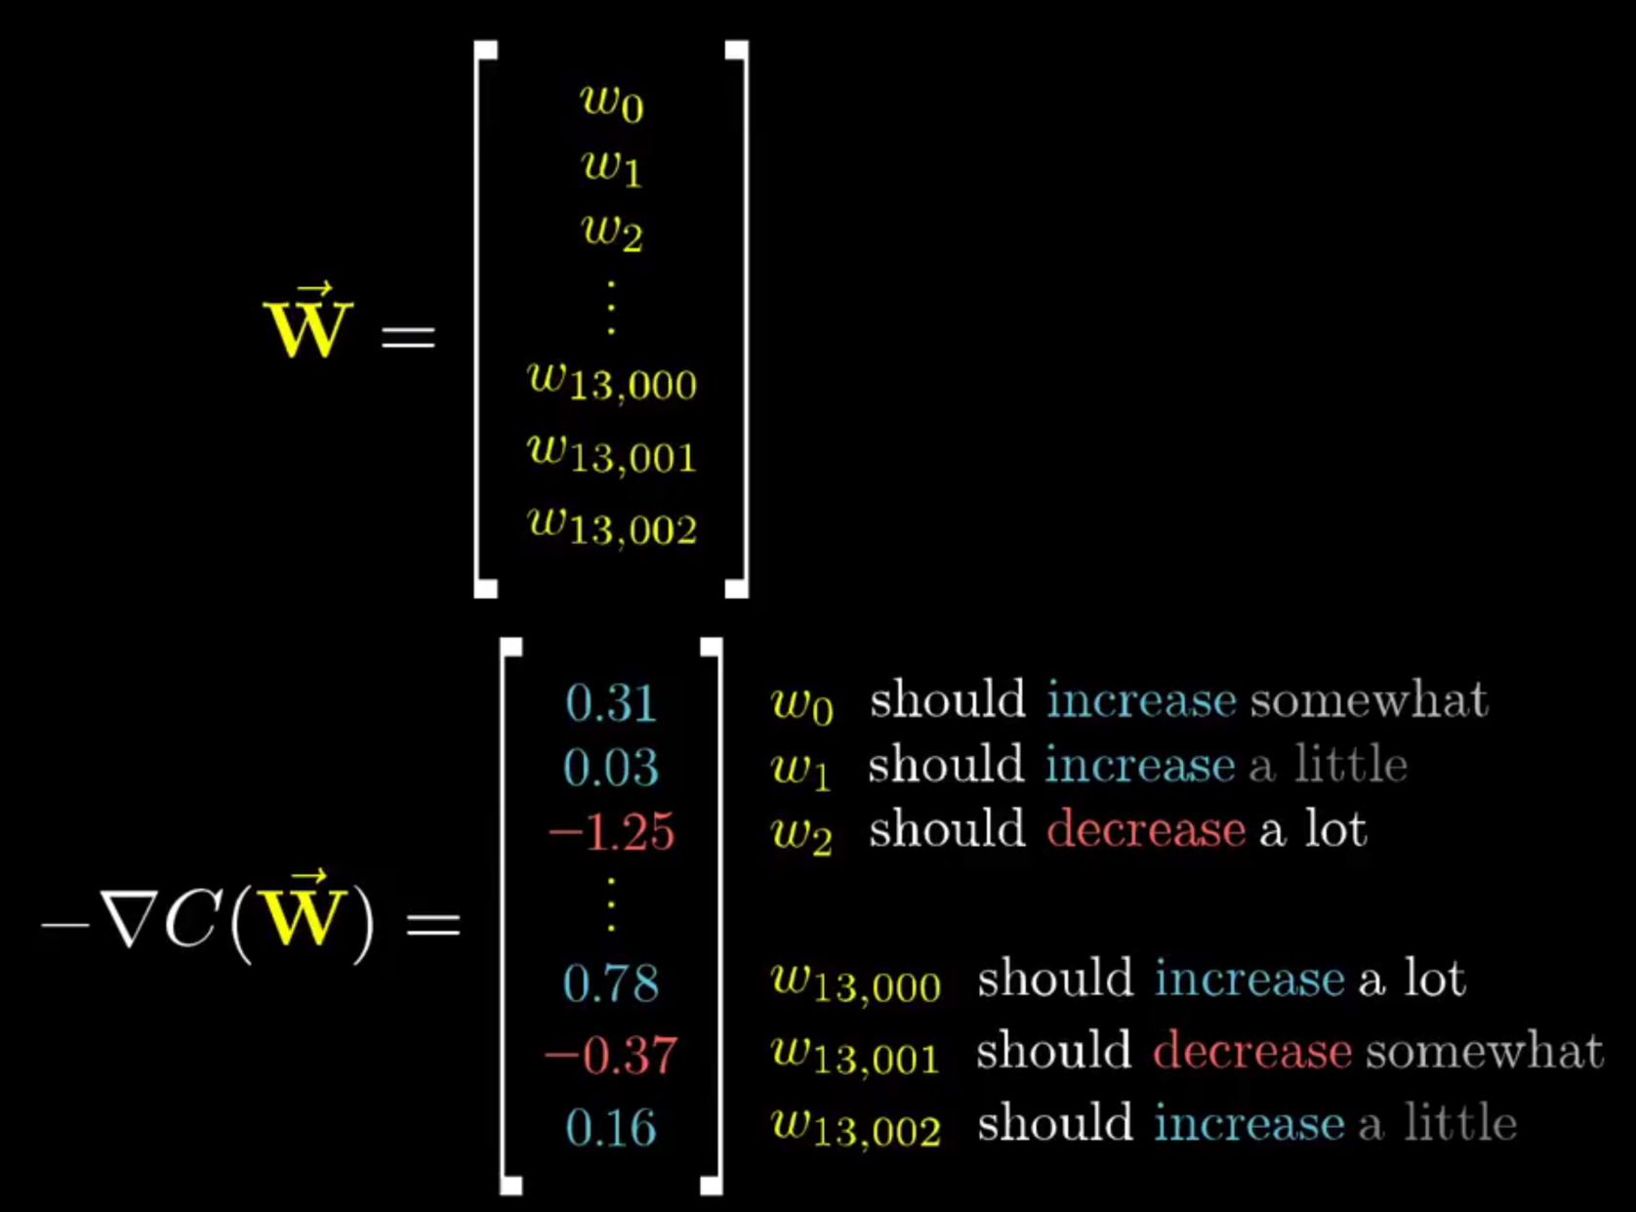
ARTIFICIAL NEURAL NETWORKS
LEARNING

Slide 28
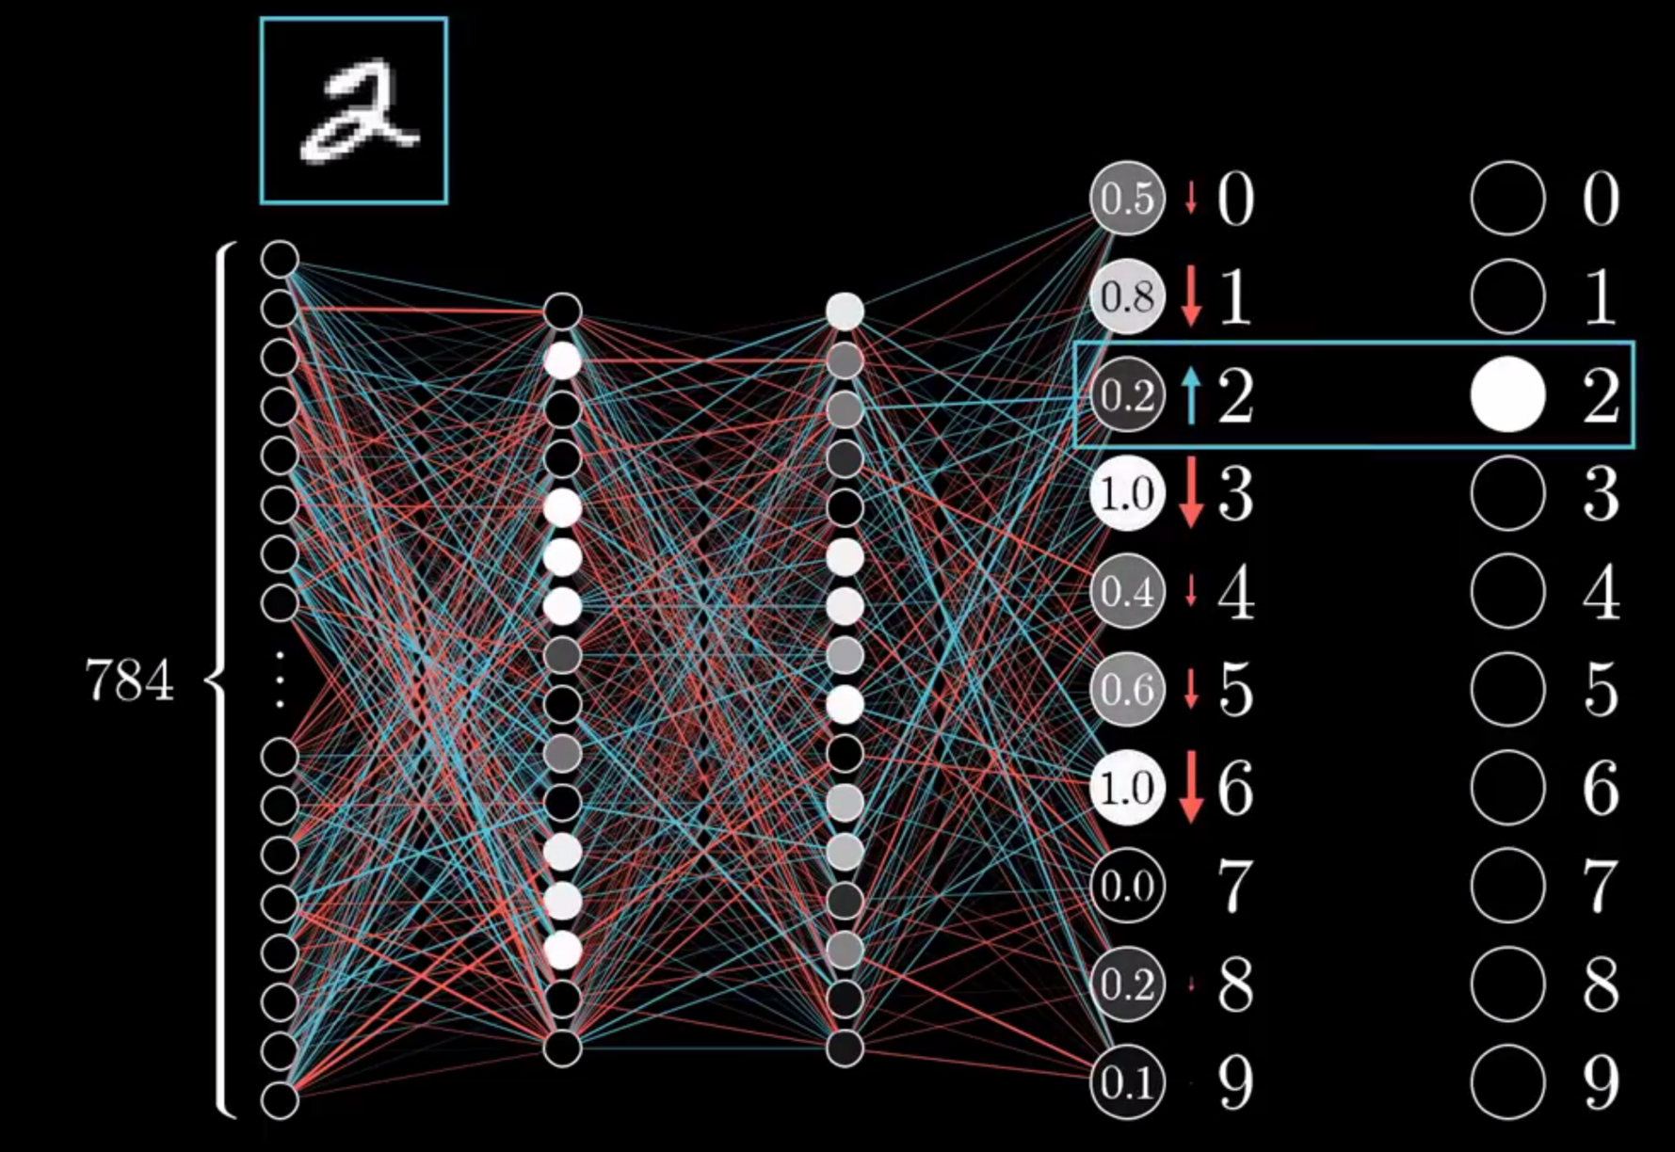
ARTIFICIAL NEURAL NETWORKS
LEARNING

Slide 29
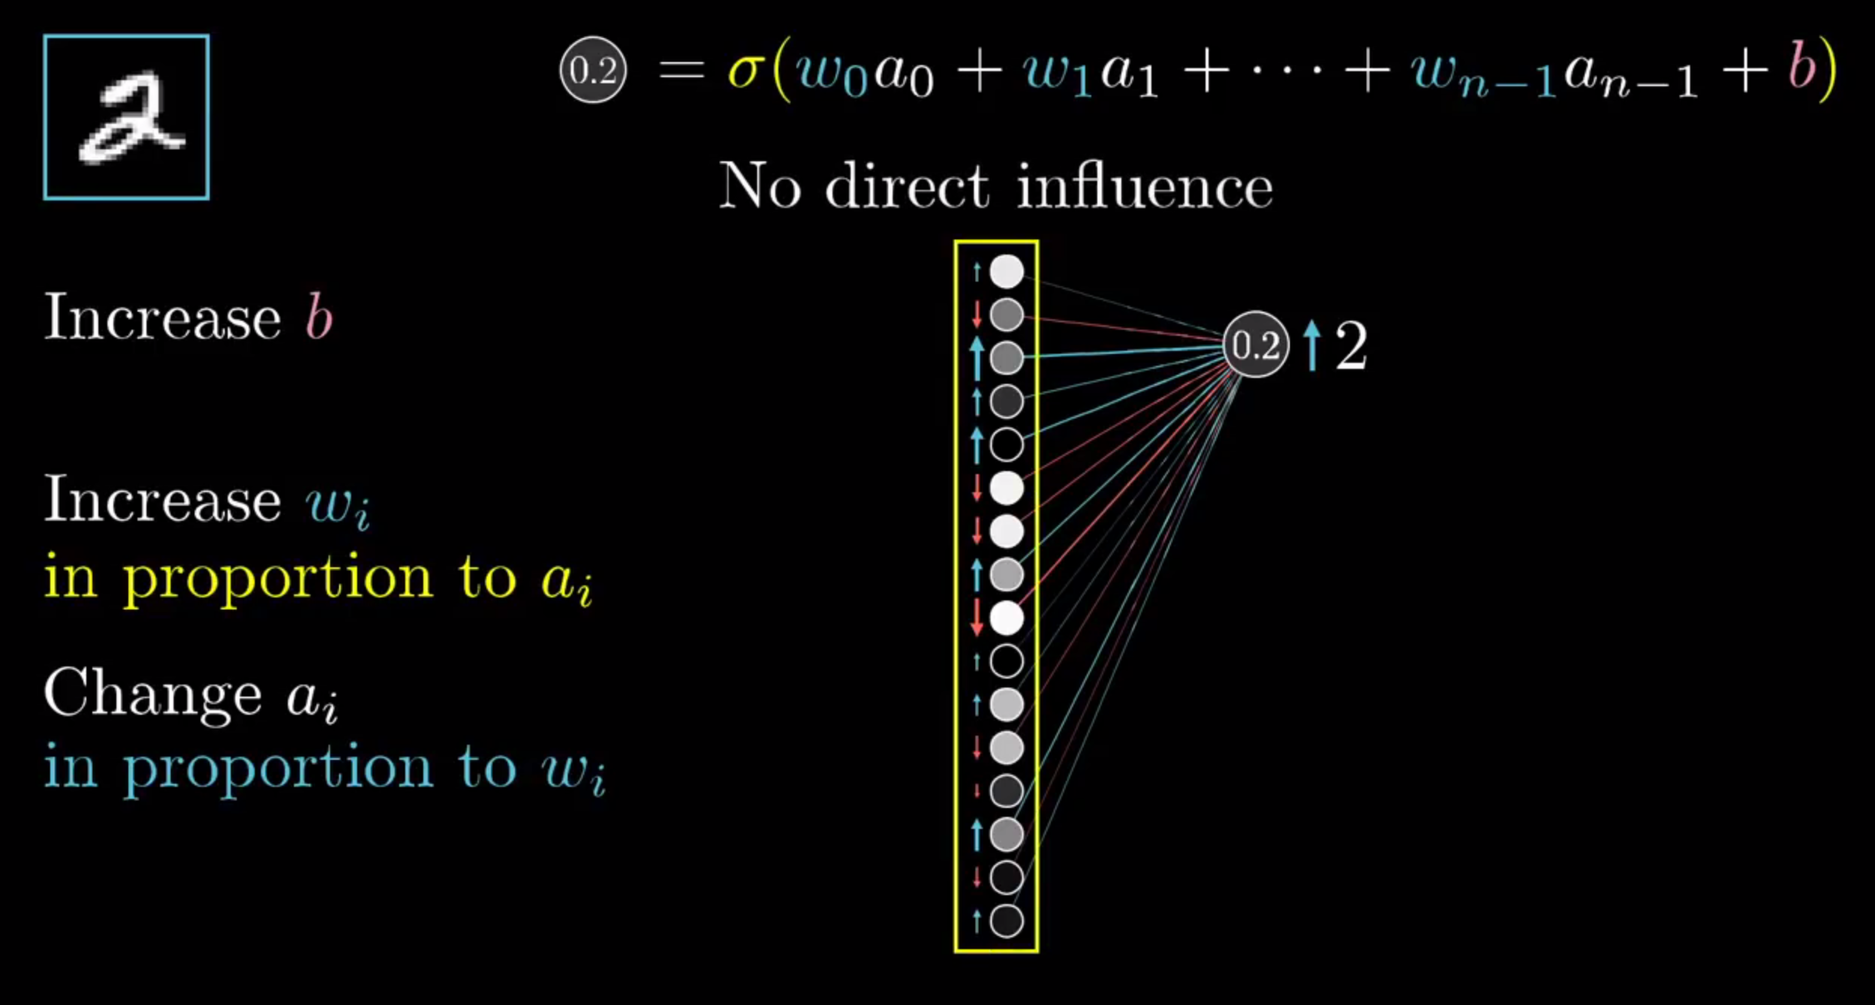
ARTIFICIAL NEURAL NETWORKS
LEARNING

Slide 30
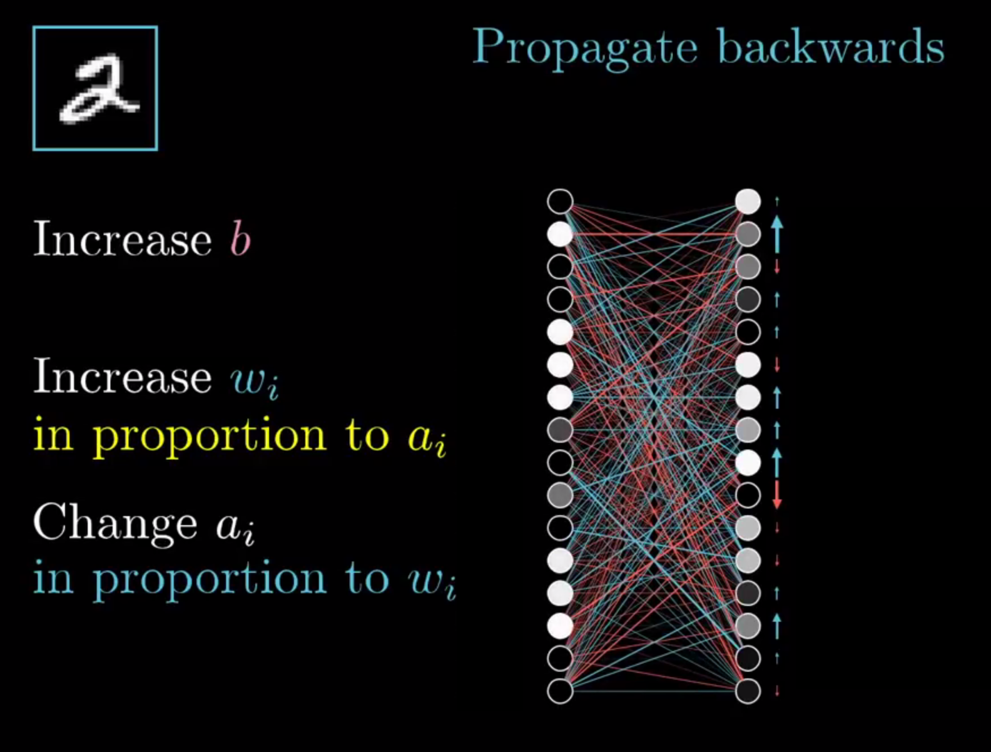
ARTIFICIAL NEURAL NETWORKS
LEARNING

Slide 31
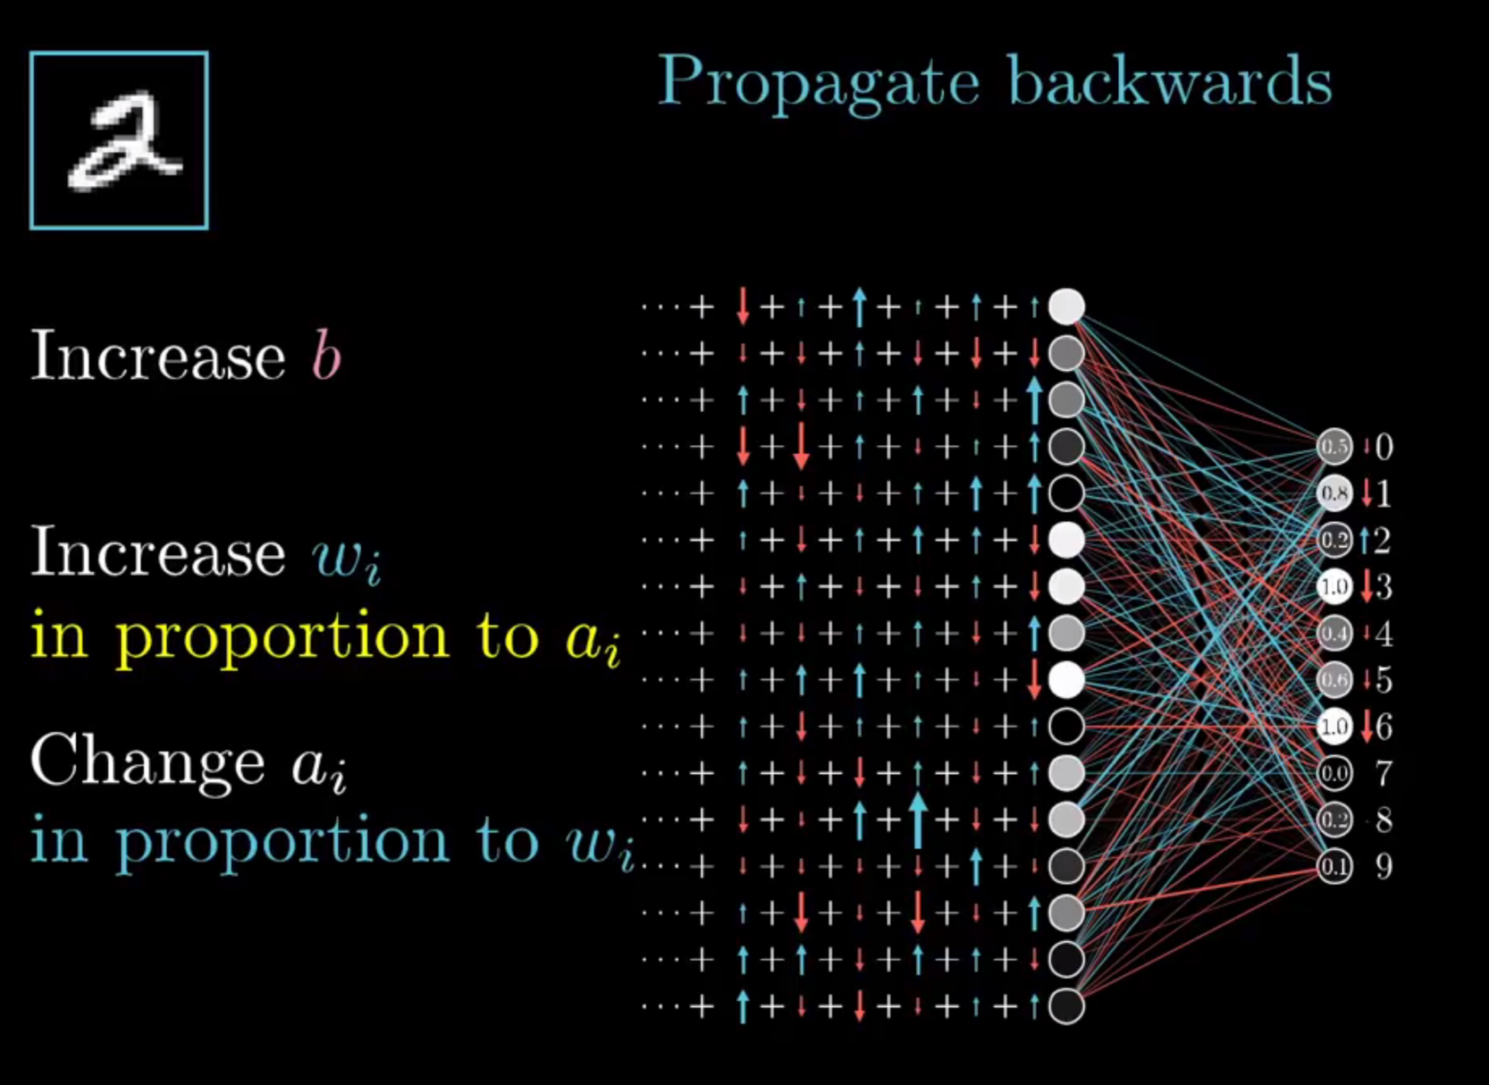
ARTIFICIAL NEURAL NETWORKS
LEARNING

Slide 32
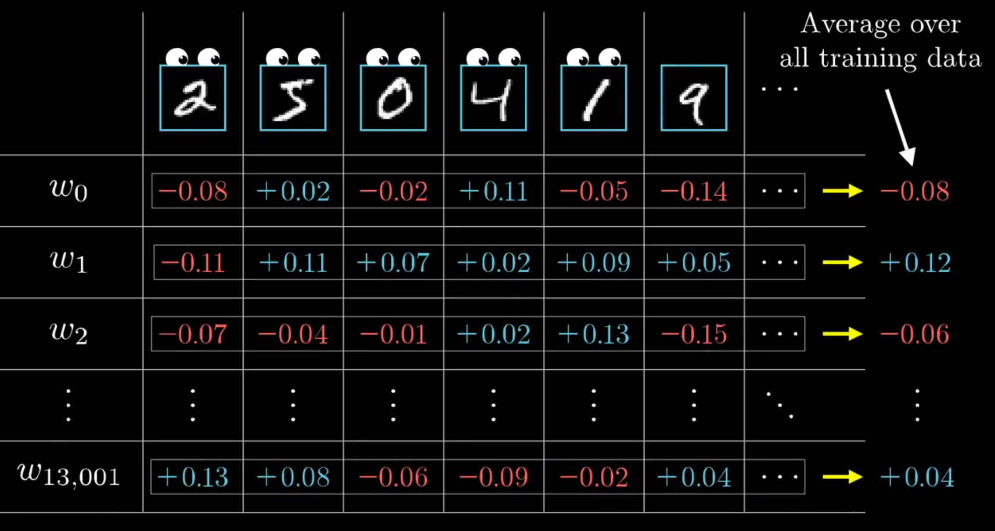
ARTIFICIAL NEURAL NETWORKS
LEARNING

Slide 33
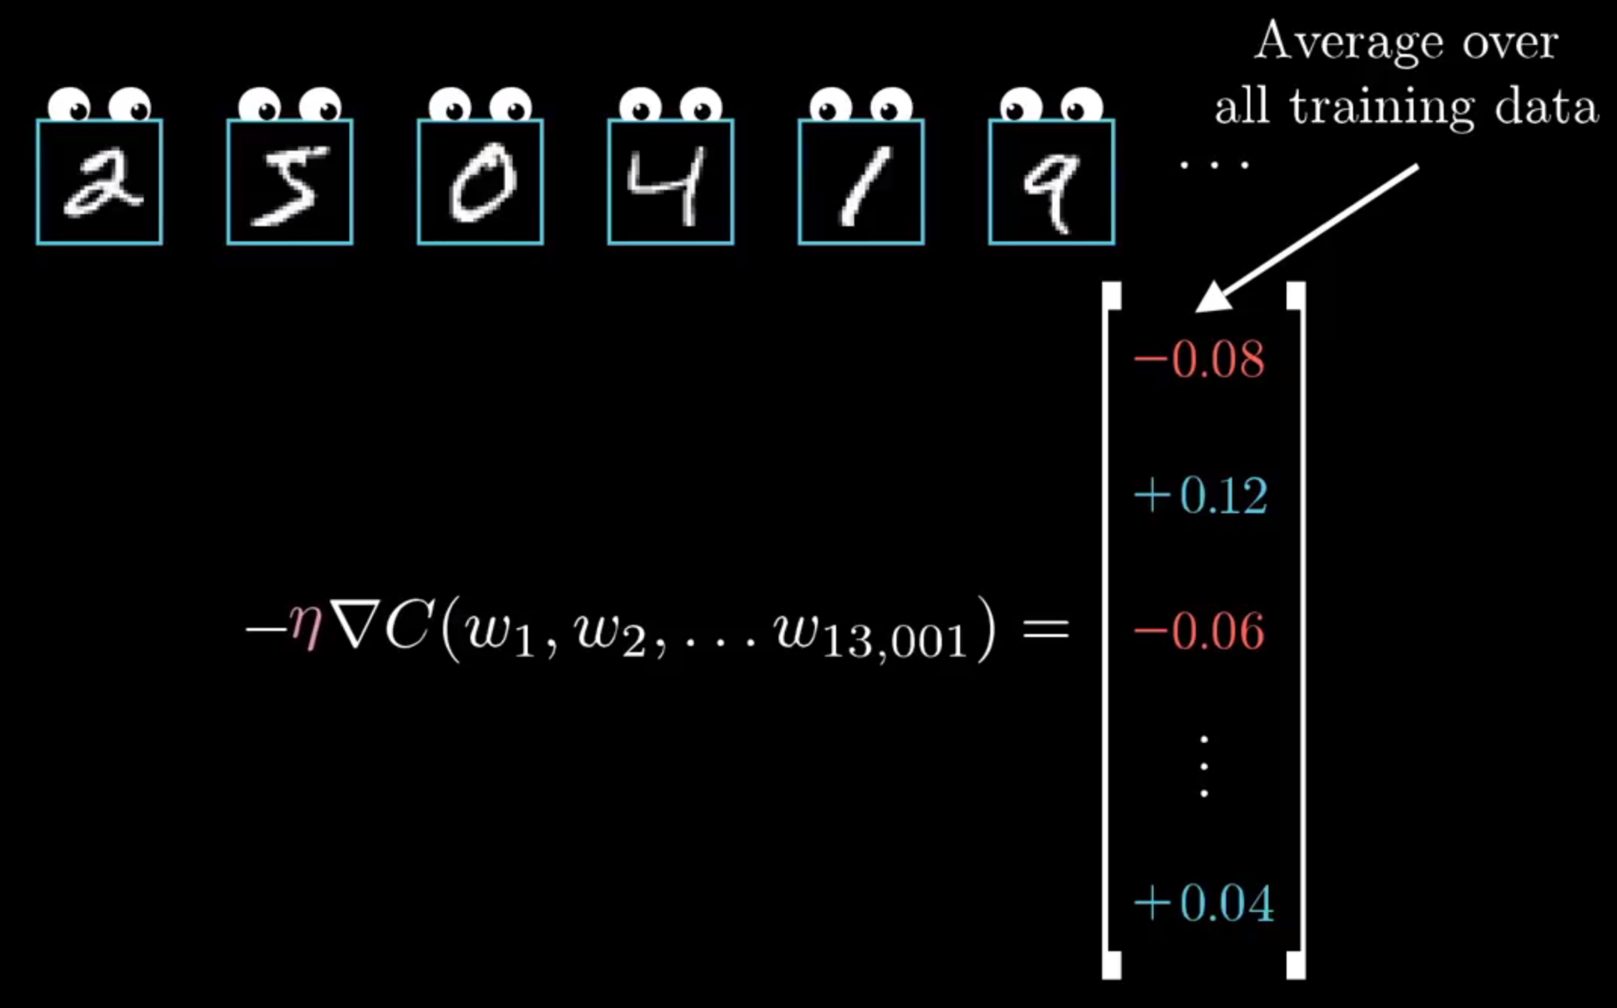
ARTIFICIAL NEURAL NETWORKS
LEARNING

Slide 34
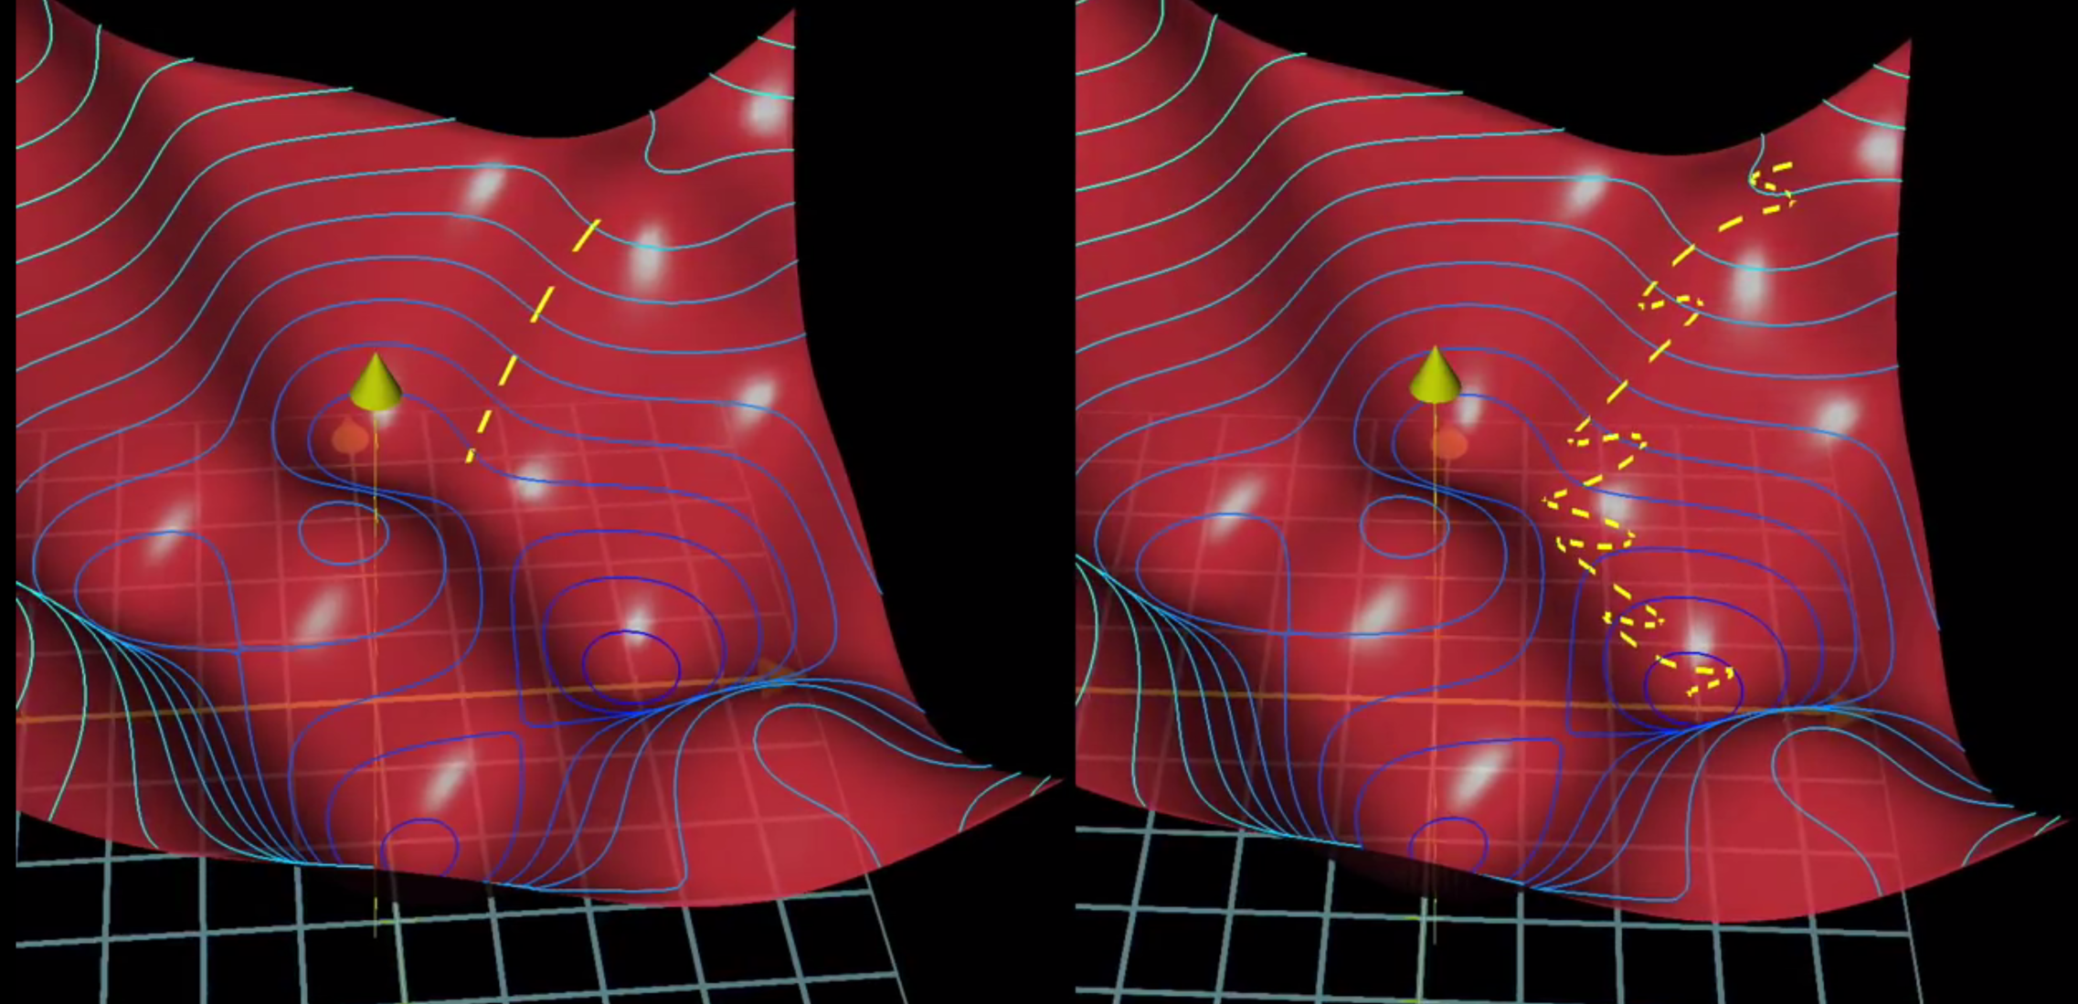
ARTIFICIAL NEURAL NETWORKS
STOCHASTIC LEARNING

Slide 35
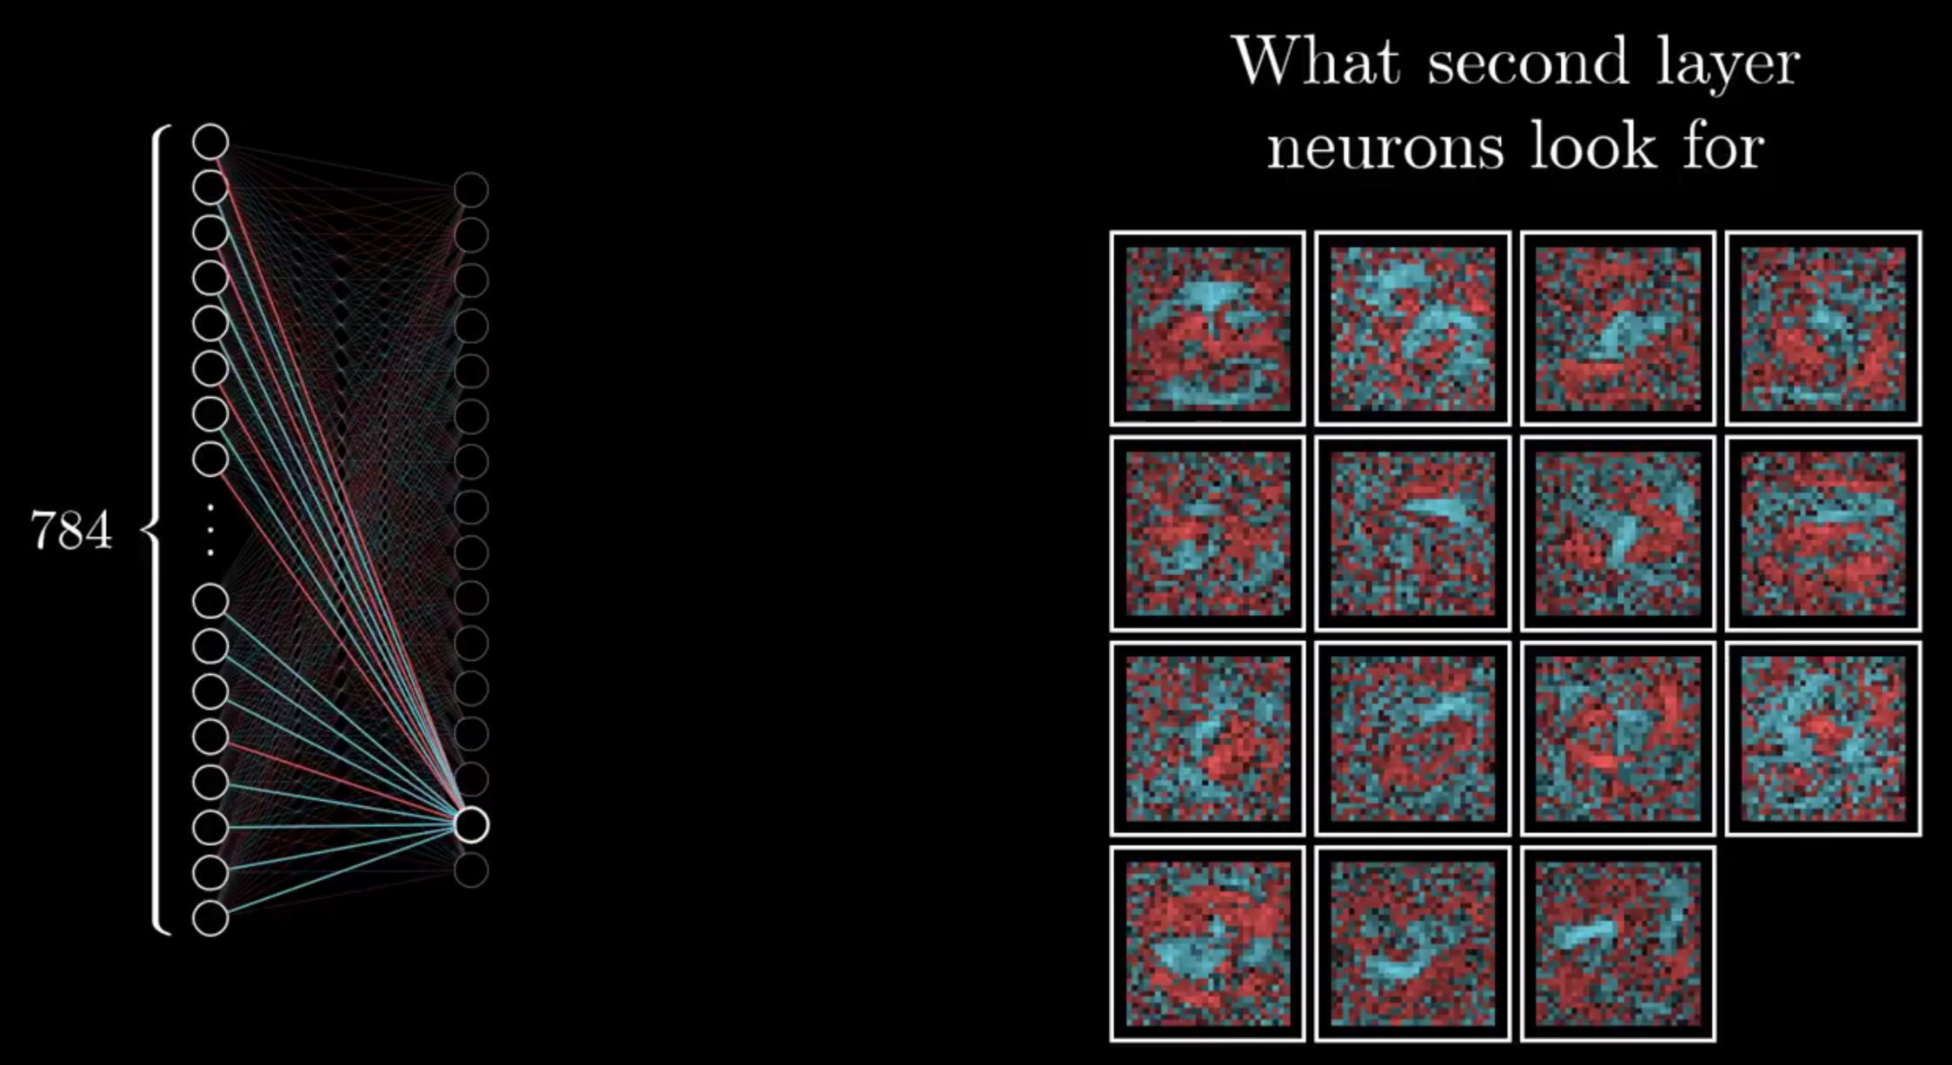
ARTIFICIAL NEURAL NETWORKS
POSSIBLE MEANING – LAYERS OF ABSTRACTION

Slide 36

ARTIFICIAL NEURAL NETWORKS
POSSIBLE MEANING – LAYERS OF ABSTRACTION

Slide 37

ARTIFICIAL NEURAL NETWORKS
CODE

